Slide 1

Multi-Objective Extractive Text Summarization
Sri Ramajayam
Batch : C6
Akshaya Rohith M(224003008)
Hariharan Subramanian(224003032)

Slide 2
Problem Statement:
Extractive summarization selects a subset of sentences from the given text to form a summary.
Summarization involves various factors , out of which coverage and redundancy reduction are the objectives which we have taken into account
We have also addressed some of the constraints like Summary length
Our aim, is to incorporate these objectives and constraints into our optimization model and get the extractive summary of the given full text.

Slide 3
Problem Formulation:
Objectives
Constraints
Potential Solution Obtained
We shall tackle Coverage as the 1st objective, along with the redundancy reduction objective as the 2nd one.
We are abiding by the length limit of the summary ( no of sentences to be included into the summary )
At the end, an extractive summary of the given multi document is obtained

Slide 4
Overall Layout of the Project
Preprocess the full-text
Choose a Multi-Objective Evolutionary Computing Algorithm
Randomly Initialize a population for that EC algorithm
Calculate the objectives
Execute the MOEC Algorithm steps for n no of iterations and run until termination criteria met
Best solution is extracted from the final optimal pareto front
F1-Coverage, F2-Redundancy Reduction
Calculate the sentence representations
Choose a similarity measure

Slide 5
Preprocessing
This step includes Segmentation, Tokenization, Removing stop words and stemming the rest of the words
Population Initialization
Randomly initialization of population of bees, each bee represents a potential solution.
Each bee will be in the form of a decision vector containing 0’s and 1’s representing the selection of the words into the summary
Optimization Algorithm Execution
MOABC algorithm executes for a predefined no.of. Iterations and returns a non-dominated set of solutions known as pareto front.
Single Solution selection
Single solution is selected from the pareto set using approaches like Consensus, Mahalonobis distance ets.,

Slide 6
Preprocessing
Segmentation : Splitting of documents into separate sentences
Tokenization : Splitting each sentences into its constituent words
Removing stop words : Each word is then fed into NLTK stop words package and removed if present
Stemming : Each word is then converted into root form by porter stemming

Slide 7
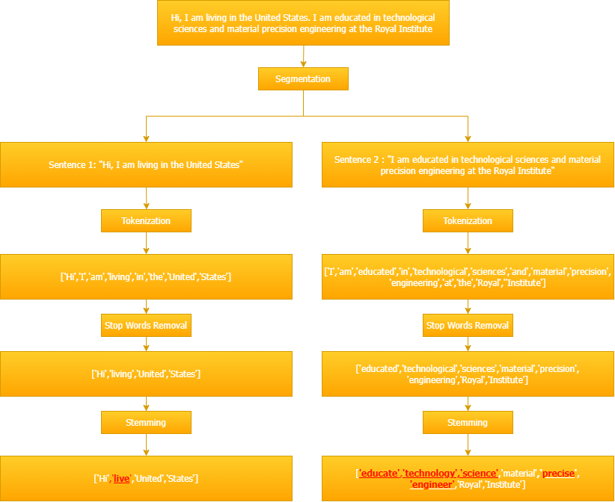

Slide 8
2. Sentence Representations
We have chosen to use tf isf or term frequency-inverse sentence frequency representations.
This is the most used representation in Unsupervised learning approaches in extractive text summarization
We use the TF-ISF representation since the ISF part captures the presence of unique terms across the document that occur less frequently
At the end we obtain 2 components:
The w_{ik} matrix – which reflects the weight of a term k in a sentence I
The mean document vector o – this reflects the centre of the document and is the average of w_{ik} vectors

Slide 9
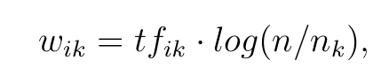
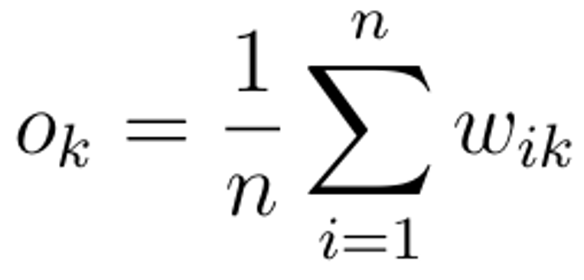
Weights Calculation
Term frequency Calculation
tf_{ik=}Term frequency of k in ith sentence
Weights Calculation
n_{k}=no. of sentences that contain term k
Mean vector Calculation

Slide 10
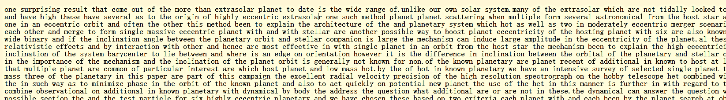
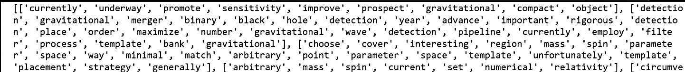
Sample
Text:
Segmented Sentences:
 | T0(promote) | T1(year) | T2(hole) | T3(order) | T4(mass) | T5(set) | T6(spin)
S1 | 0.13 | 0.57 | 0.26 | 0.44 | 0.86 | 0.74 | 0.24
S2 | 0.67 | 0.28 | 0.29 | 0.47 | 0.48 | 0.36 | 0.74
S3 | 0.89 | 0.65 | 0.87 | 0.45 | 0.87 | 0.23 | 0.01
S4 | 0.34 | 0.48 | 0.73 | 0.66 | 0.49 | 0.34 | 0.34
S5 | 0.56 | 0.87 | 0.79 | 0.32 | 0.42 | 0.48 | 0.01
S6 | 0.12 | 0.95 | 0.23 | 0.89 | 0.35 | 0.49 | 0.85
S7 | 0.37 | 0.58 | 0.74 | 0.04 | 0.32 | 0.95 | 0.13
S8 | 0.14 | 0.56 | 0.70 | 0.35 | 0.69 | 0.03 | 0.22
Term frequency
vectors :
Sentence to word weightage matrix
(wik)

Slide 11
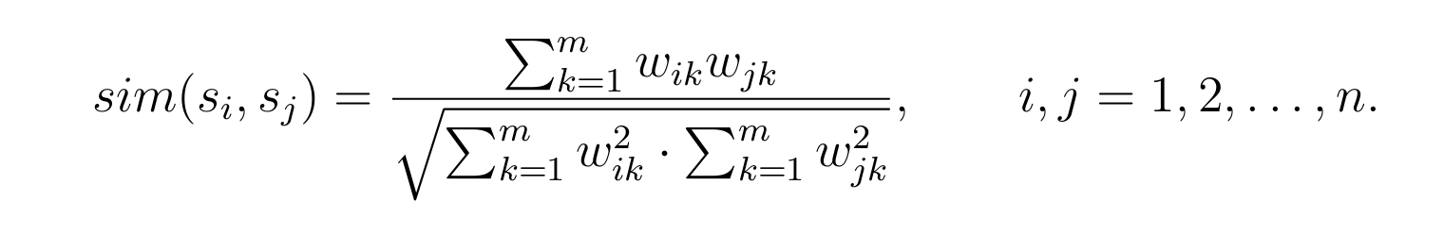
3. Similarity Measure
The main role of a similarity measure, is to quantify the similarity between any 2 numerical vectors
Many measures exist like:
Normalized Google Distance
Word Movers Distance
Cosine Similarity Measure
Again, Cosine similarity measure is the most commonly used in the previous literature

Slide 12
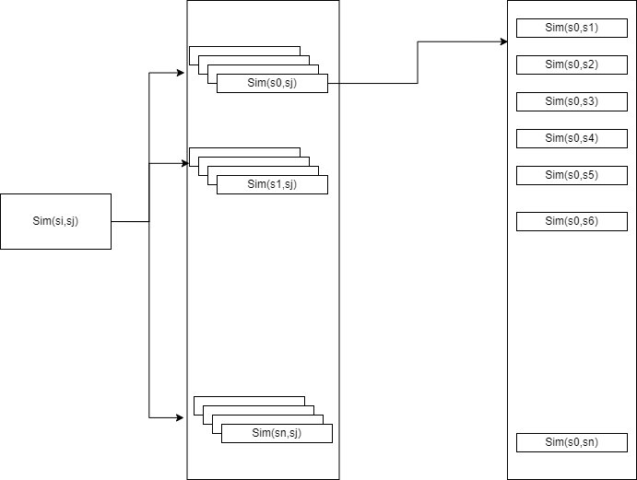
Similarity Measure Computation and Caching
Here the similarity values of each sentence si with all the other sentences sj are cached in a dictionary
The similarity value is calculated based on the expression shown in the previous slide
This is used to increase the computational speed

Slide 13
4. Choose a Multi Objective Evolutionary Computing Algorithm
Multi Objective Evolutionary Computing
Multi Objective Artificial Bee Colony (MOABC)

Slide 14
5. Colony Initialization - MOABC
An MOABC population consists of 50 members
Each member consists of #no. of sentences bit positions
Each position can take a value 0 or 1(0 not taken, 1 taken into candidate summary)

Slide 15
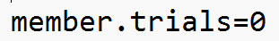
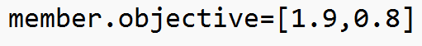
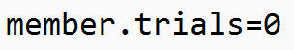
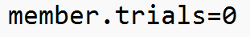
What does colony initialization mean? How does a colony look like??
Colony Format
Member 1
Initialized colony
Member 2
Member 3
Member 4
Member 5
Member Format
Member 6
Updated colony
Member …..
Member 48
Member 49
Member 50

Slide 16
MOABC
Population Updating
Send Employed Bees
NDS Archive Updating
Send Onlooker Bees
Send Scout Bees
For the First iteration, Initialize a random population and Feed into the MOABC Algorithm

Slide 17
Employee Bee Phase:
Mutation operator application: For each solution , mutation operation is carried out based on a predefined condition
Domination criteria check: Each solution and its newly mutated form is subjected to a Domination criteria check
Replacement: If the newly mutated solution is more efficient than the original one, replace the original solution with the mutated one

Slide 18
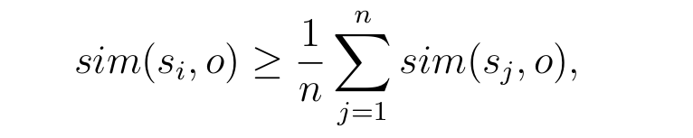
Mutation Operator
Original vector
0 | 1 | 1 | 0 | 0 | 1 | 1 | 0 | 0 | 0
Mutation Probability Check
value<=0.1(pm)
Random vector
0.3 | 0.6 | 0.8 | 0.7 | 0.1 | 0.6 | 0.5 | 0.4 | 0.3 | 0.9
Average Sentence Similarity Check
O- central theme of the document represented
In the vector format
Yes
No
0 | 1 | 1 | 0 | 1 | 1 | 1 | 0 | 0 | 0
0 | 1 | 1 | 0 | 0 | 1 | 1 | 0 | 0 | 0

Slide 19
Average Sentence Similarity Check
Similarity of a sentence with the mean document vector
Mean similarity of a sentence with the mean document vector

Slide 20
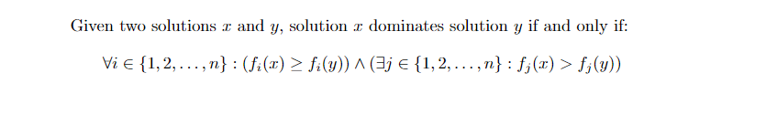
Dominance Criteria Check
The dominance criteria is used to compare 2 members or objective vectors
In our case, since we have 2 objectives, the objective vectors shall be of dimension = 2. Let the members be i and j, and their corresponding objective vectors be v_{i} and v_{j}
Mathematically :
The dominance criteria can return either of the 3 below outputs:
Dominance(v_{i},v_{j})
v_{i} : This means v_{i} dominates v_{j}
None : This is the non-dominating condition
v_{j} : This means v_{j} dominates v_{i}

Slide 21
Domination criteria check
Candidate Summary : i
v_{i} : (z1,z2)
Candidate Summary : j
v_{j} : (z1,z2)
If z1,i>z1,j and z2,i>=z2,j
If z1,i>=z1,j and z2,i>z2,j
If z1,j>z1,i and z2,j>=z2,i
If z1,j>=z1,i and z2,j>z2,i
If z1,i >z1,j but z2,i <z2,j
If z1,i <z1,j but z2,i >z2,j
Summary i dominates j
Summary j dominates i
Non-Dominating condition

Slide 22
A simple example of domination criteria
vi : (6,3)
vj : (1,3)
Dimension 1 : 6>1
Dimension 2: 3>=3
Hence vi dominates vj
vi : (6,3)
vj : (1,7)
Dimension 1 : 6>1
Dimension 2: 7>3
Neither vi dominates vj or vj dominates vi -> Non-Dominating Condition
vi : (2,3)
vj : (4,3)
Dimension 1 : 2<4
Dimension 2: 3<=3
Hence vj dominates vi

Slide 23
Onlooker bee phase:
Mutation operator application: For each solution , mutation operation is carried out based on a predefined condition
Domination criteria check: Each solution and its newly mutated form is subjected to a Domination criteria check
Replacement: If the newly mutated solution is more efficient than the original one, replace the original solution with the mutated one
Probability Calculation:
A probability value is calculated based on the rank and crowding distance of the solution
Roulette wheel selection:
Based on the cumulative probability calculated in the previous step , a member is selected
Ranking and Crowding : Each member is assigned a rank and crowding distance based on the NSGA II algorithm

Slide 24
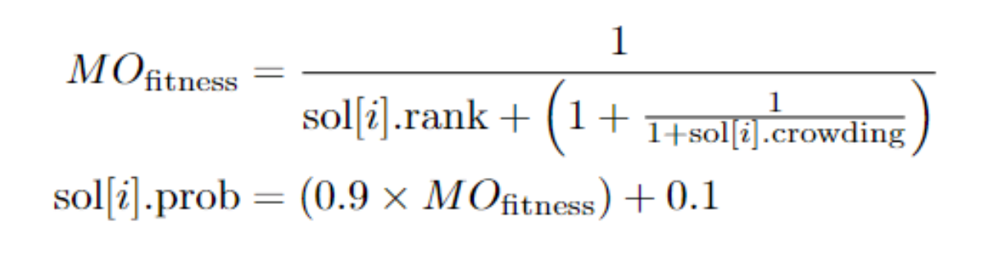
Probability value Calculation

Slide 25
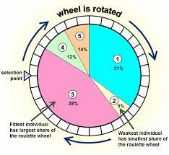
Roulette Wheel Selection
Probability of selecting an individual is directly proportional to its fitness value relative to the total fitness of the population.
Think of it as a roulette wheel where each individual occupies a portion of the wheel's circumference proportional to its fitness.
Roulette Wheel Selection favors individuals with higher fitness values, but it still allows less fit individuals to have a chance of being selected.
This helps maintain diversity in the population and prevents premature convergence to a suboptimal solution.

Slide 26
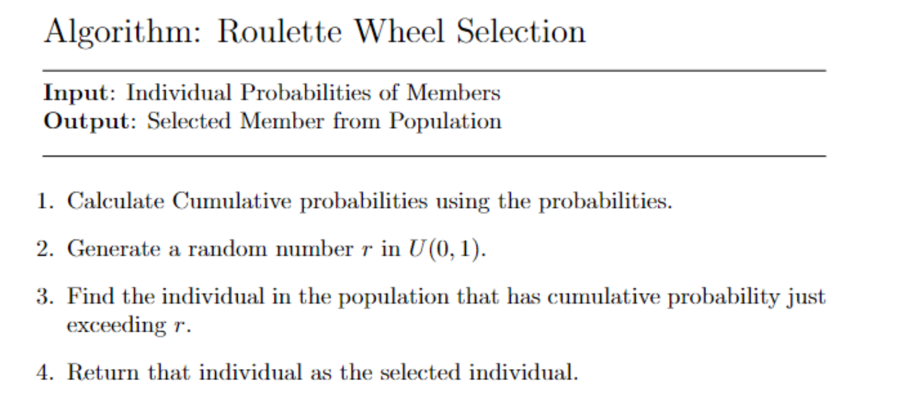
Algorithm for Roulette Wheel Selection

Slide 27
Scout bee phase:
Domination criteria check: Each solution and its newly mutated form is subjected to a Domination criteria check
Replacement: If the newly mutated solution is more efficient than the original one, replace the original solution with the mutated one
Random Replacement: If no dominated solution is found that dominates the current solution , then a random solution is generated and replaced
Trial Check: For each candidate solution , the trial value is checked , if no.of.trials > Threshold -> Proceed..
Mutation operator application: For each solution , mutation operation is carried out based on a predefined condition

Slide 28
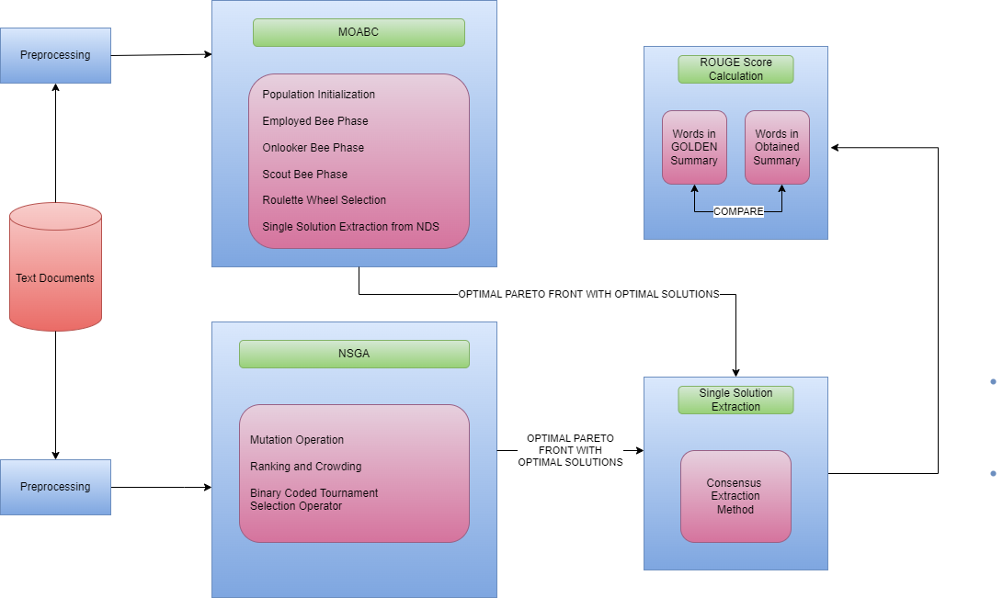
Architecture Diagram

Slide 29
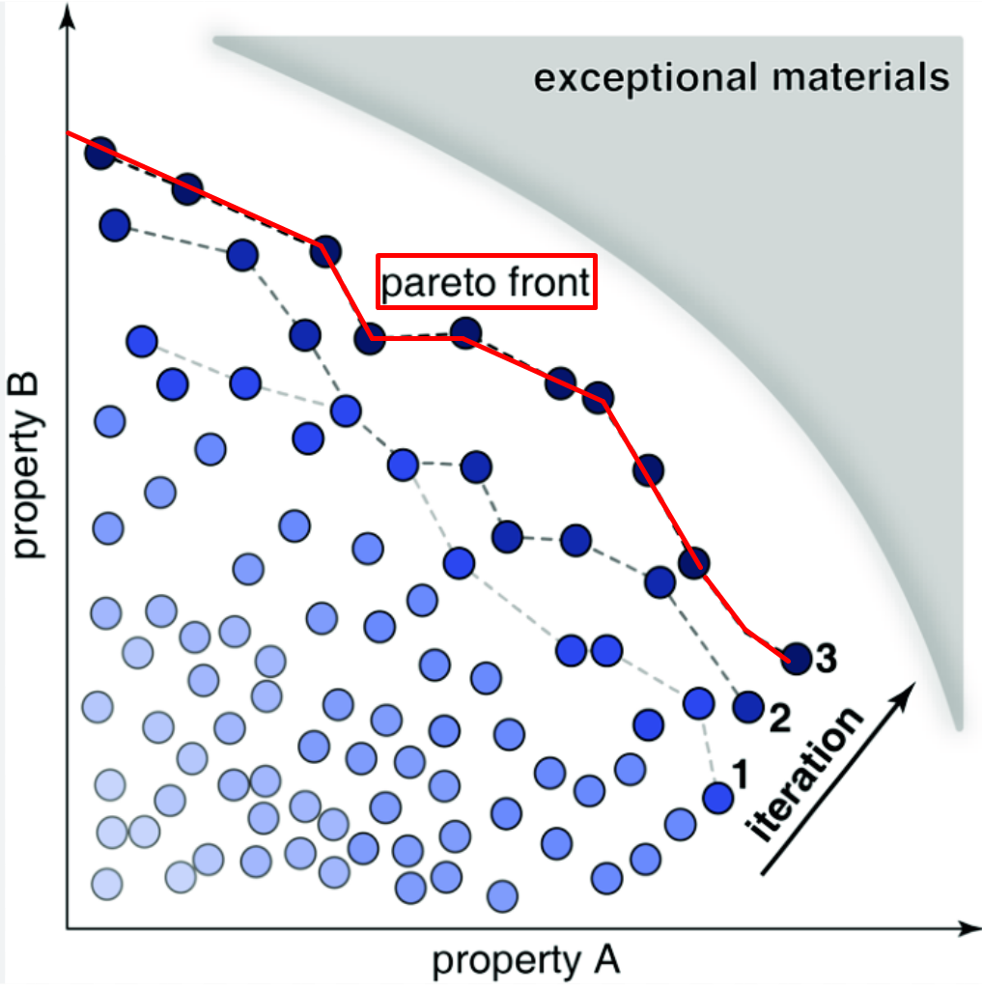
What is pareto front?
We have multiple conflicting objectives that you want to optimize simultaneously.
The Pareto front consists of solutions that achieve the best trade-offs between these conflicting objectives.
A solution is considered Pareto optimal if there is no other solution that is better in all objectives.
The Pareto front, then, represents the boundary of the objective space where no further improvement in one objective can be made without sacrificing another objective.

Slide 30
Ranking and Crowding Procedure
Calculate the objective values
Perform fast non-dominated sorting algorithm
Assign ranks based on the sorting algorithm
Perform Crowding Distance calculations
Assign fitness values based on rank and CD

Slide 31
Ranking
Evaluate each solution for both the objective values ( In our case, Coverage and Redundancy )
 | F1-Coverage | F2-Redundancy
M1 | 0.178 | 0.345
M2 | 0.346 | 0.369
M3 | 0.683 | 0.532
M4 | 0.756 | 0.976
M5 | 0.129 | 0.998
M6 | 0.566 | 0.245
. | . | .
. | . | .
. | . | .
M50 | 0.887 | 0.447

Slide 32
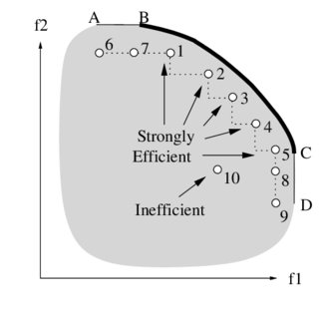
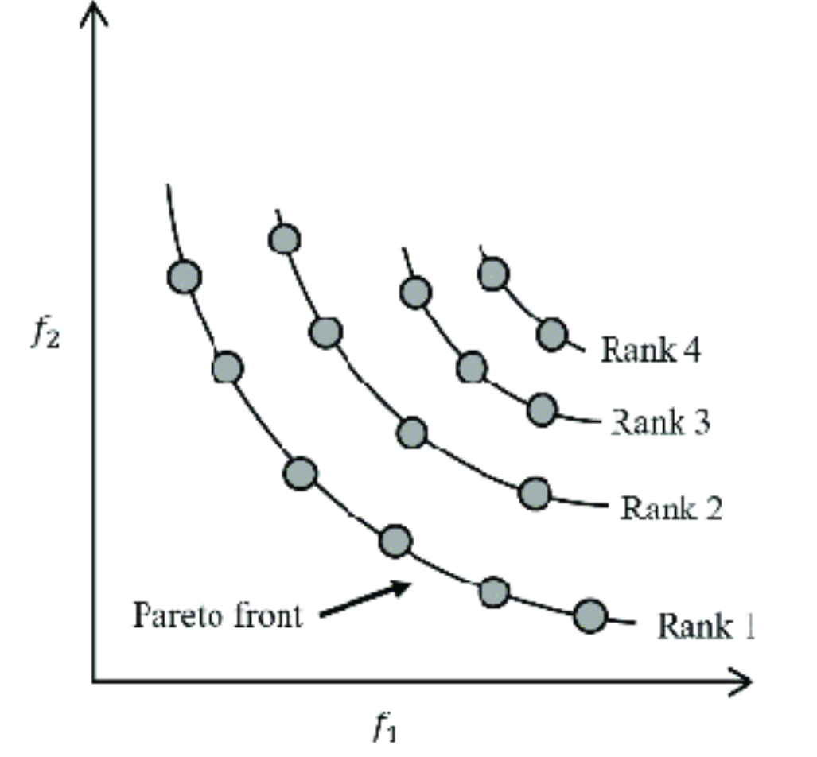
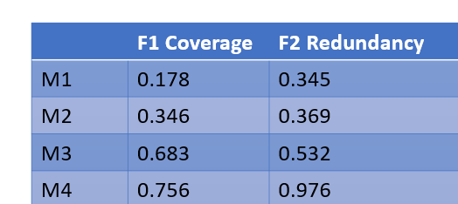
Assign rank to each solution using dominance depth
The strongly efficient candidates are ranked as 1 , and the lesser strongly efficient candidates are ranked as 2 and so on.
To increase the ranking speed, fast non-dominated sorting algorithm is used.
Rank 3
Rank 3
Rank 2
Rank 1

Slide 33
Fast Non-Dominated Sorting Algorithm
Pareto Dominance: A solution A is said to dominate solution B if A is at least as good as B in all objectives and strictly better in at least one objective.
Solutions that are not dominated by any other solutions are considered non-dominated and belong to the first front.
Non-dominated Fronts: NSGA-II aims to partition the population into multiple fronts, where the first front contains non-dominated solutions, the second front contains solutions dominated only by solutions in the first front, and so on. This process continues until all solutions are assigned to fronts.
Efficient Sorting: It performs this efficiently by iteratively evaluating the dominance relationships between solutions.
It starts by initializing a set of solutions with no incoming dominance relationships (i.e. first front) and then iteratively identifies solutions that are dominated by the current front.

Slide 34
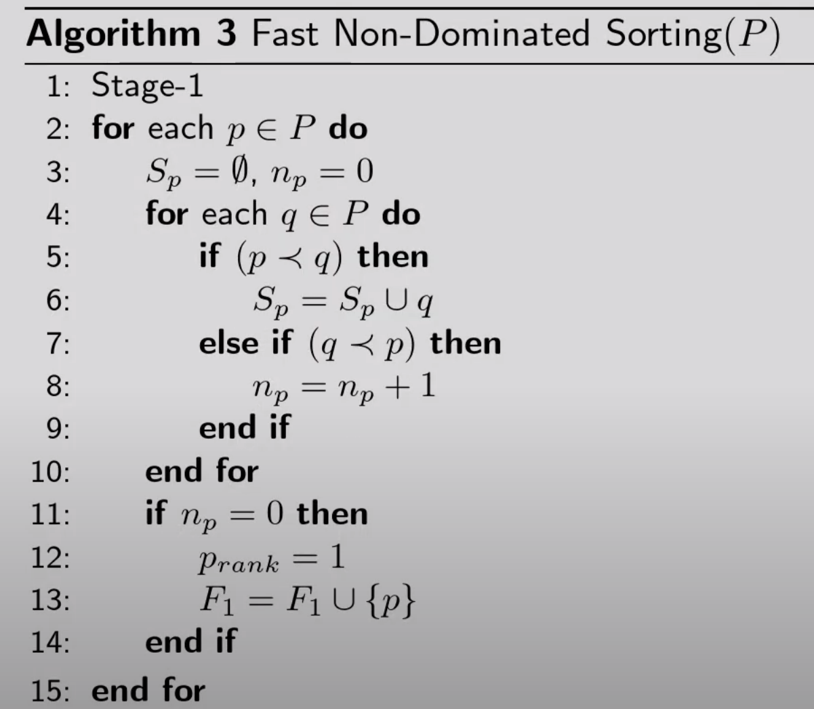
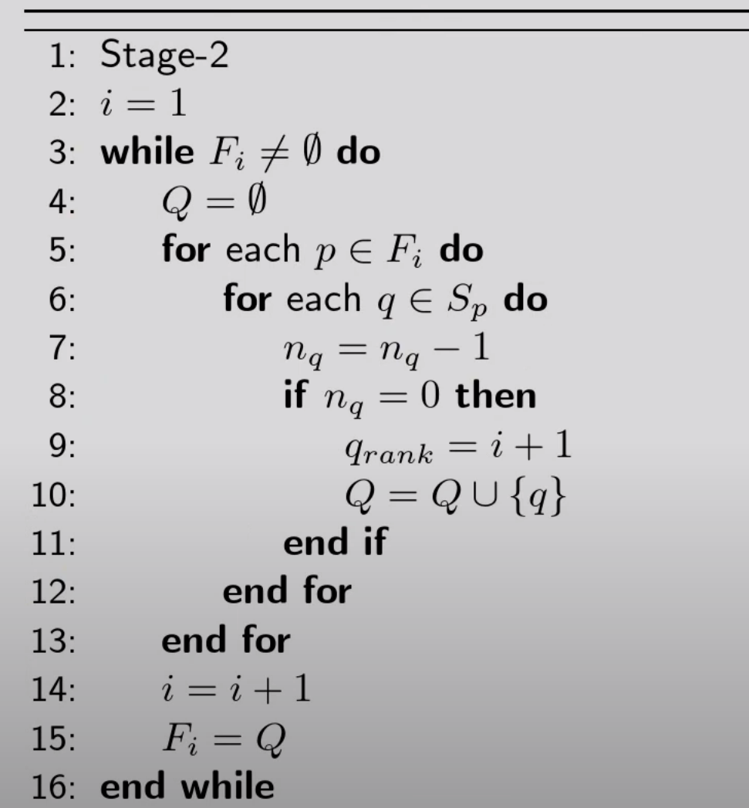
Stage 1 : Front 1 formation
Stage 2: Subsequent Front(s) formation

Slide 35
Crowding Distance
CD is used to maintain diversity among solutions in the population.
The intuition behind crowding distance is to encourage solutions to spread out evenly across the objective space.
Crowding distance measures how crowded a solution is relative to its neighbors.
Greater crowding distance → less crowded
Smaller crowding distance → densely packed
This diversity helps prevent the algorithm from converging prematurely to a single region of the objective space

Slide 36
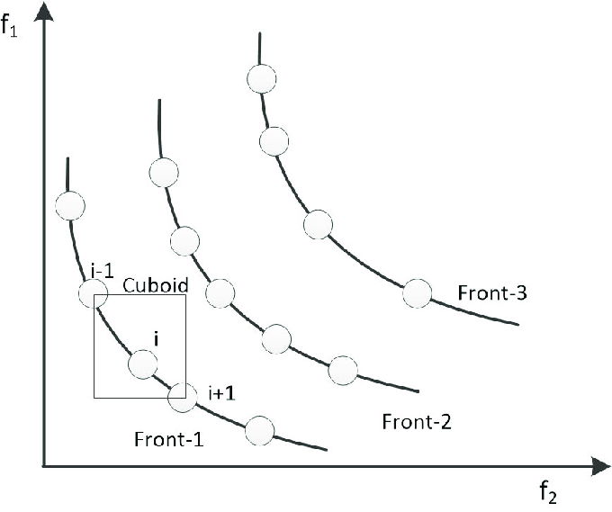
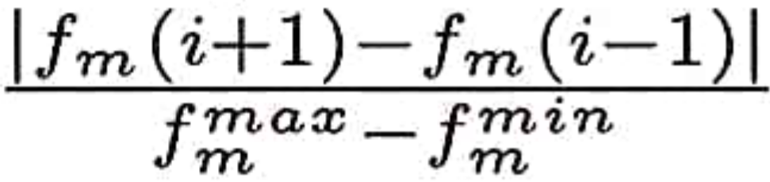
Crowding distance is assigned for each solution in each front
Crowding distance across pareto fronts is meaningless

Slide 37
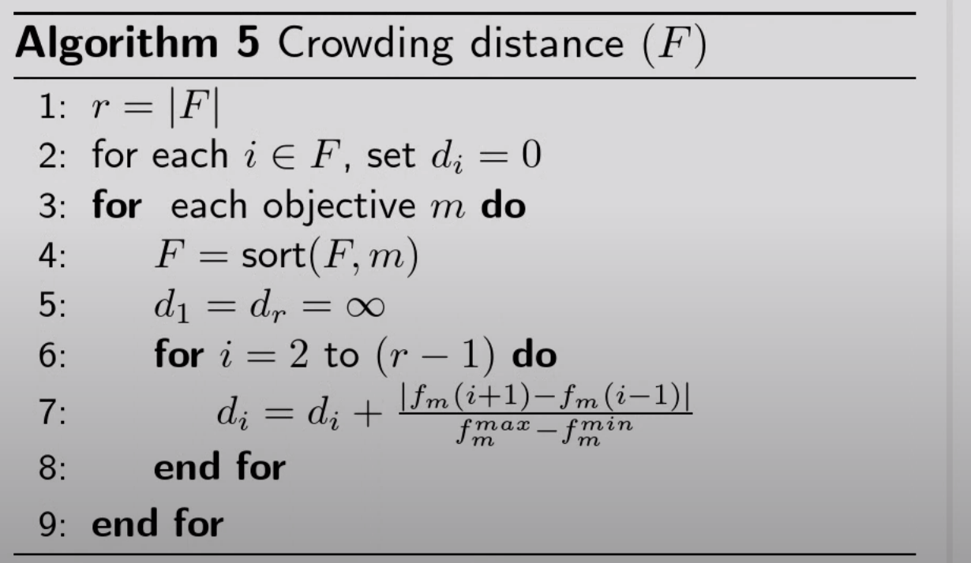
Crowding Distance Algorithm

Slide 38
Repair Operator
Sentence scores calculated and cached for access
Calculate Summary Length
While summary length>upper bound
While summary length < lower bound
Pick a random (si,sj) pair where both si,sj exist in candidate summary
If score(si) > score(sj) → Remove sj
Else → Remove si
Pick a random (si,sj) pair where both si,sj do not exist in candidate summary
If score(si) > score(sj) → Add si
Else → Add sj

Slide 39
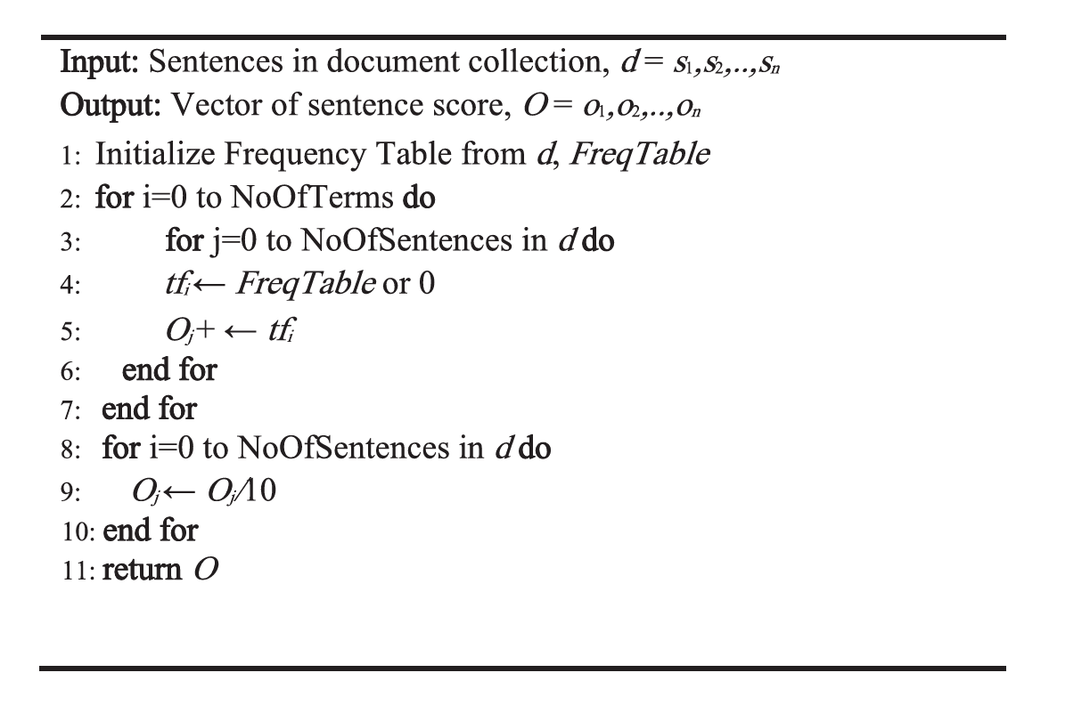
Sentence Score Calculation Algorithm

Slide 40
NDS Archive
Non-Dominated set of Solutions Archive
Obtained sets of non-dominated solutions from the population are added to the NDS archive
The addition of a member(or a deletion) is done by the dominance criteria check
For each iteration , NDS archive remains persistent and is updated
M1 [0,0,0,1,0,0,1,1,1,0,1.........0,1,1,1,0,1]
M2 [0,1,0,1,0,0,1,0,1,0,1.........0,1,0,0,0,1]
M7 [0,0,1,1,1,0,0,1,0,0,1.........0,1,1,0,0,0]
M8 [1,0,0,1,1,1,1,1,1,0,1.........1,1,1,0,0,0]
M12 [0,0,0,1,0,0,1,1,1,0,1.........0,1,1,1,0,1]
M49 [0,1,0,1,0,0,1,0,1,0,1.........1,0,1,0,0,1]

Slide 41
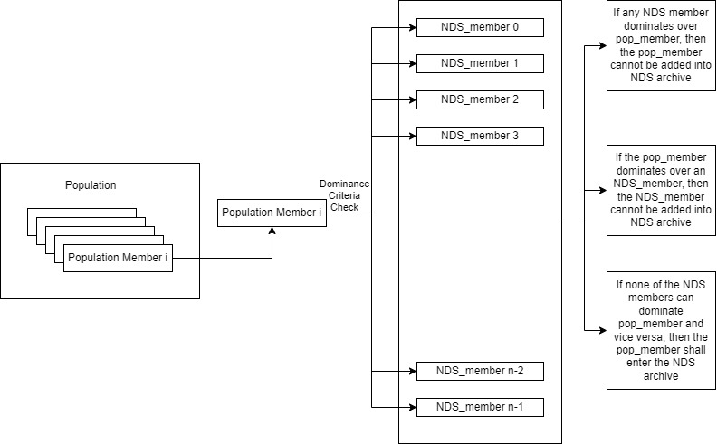
NDS Insert Function

Slide 42
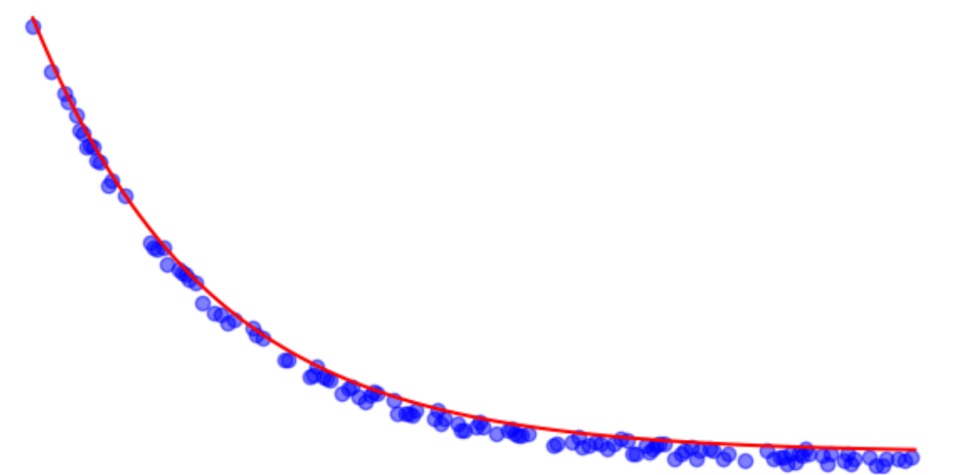
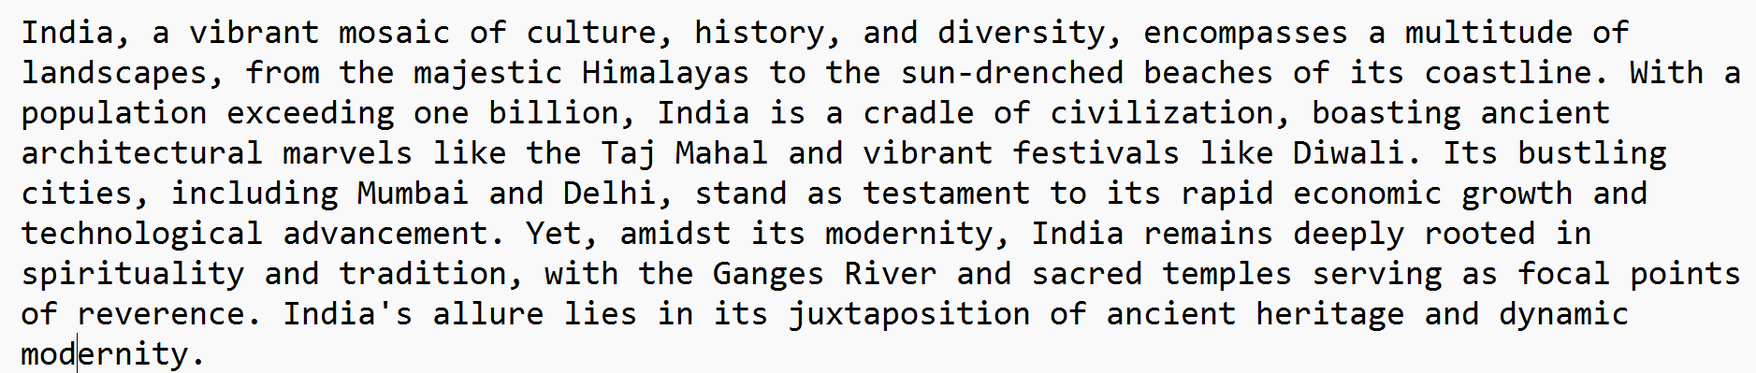
Feed full text
Final Output
Optimal Pareto Front
Single Solution Extraction from Pareto Front
Multi-Objective Evolutionary Computing Algorithm
Optimal Sentence Indices
[1,9,22,34,45,82,101,104]
Associated Extractive Summary

Slide 43
Objectives Calculation
Here, we choose the following 2 objectives
Coverage – This conveys numerically, how much the candidate summary has covered the various topics conveyed in the original full text
Redundancy – This conveys numerically, how many sentences conveying similar ideas/topics are present i.e detecting the presence of redundant sentences
Coverage and redundancy are conflicting objectives
If one needs maximum coverage, one shall have many redundant sentences in their document. At the same time, if one needs to have the least set of redundant sentences present, it shall lead to certain amount of coverage loss

Slide 44
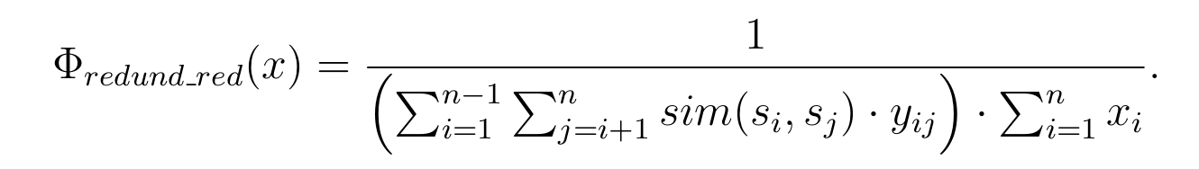
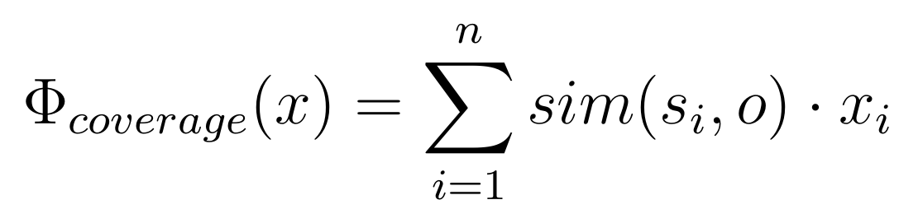
Multi Objective value=(F1,F2)
Maximizing F1=Coverage
Maximizing F2=Redundancy Reduction
Decision variable xi : whether sentence i is selected or not (0/1)
Similarity of a sentence si with another sentence sj
Penalizes long summaries
Similarity of a sentence si with mean vector o
Yij =1 if both sentences si and sj are selected, else 0

Slide 45
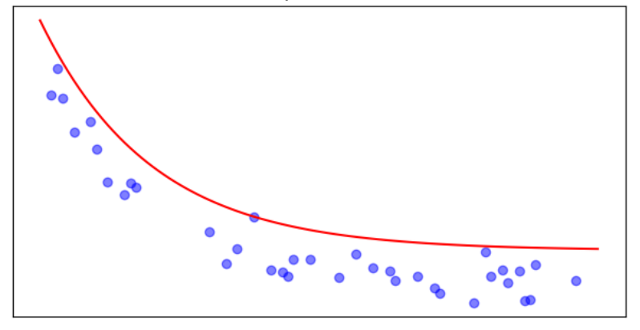
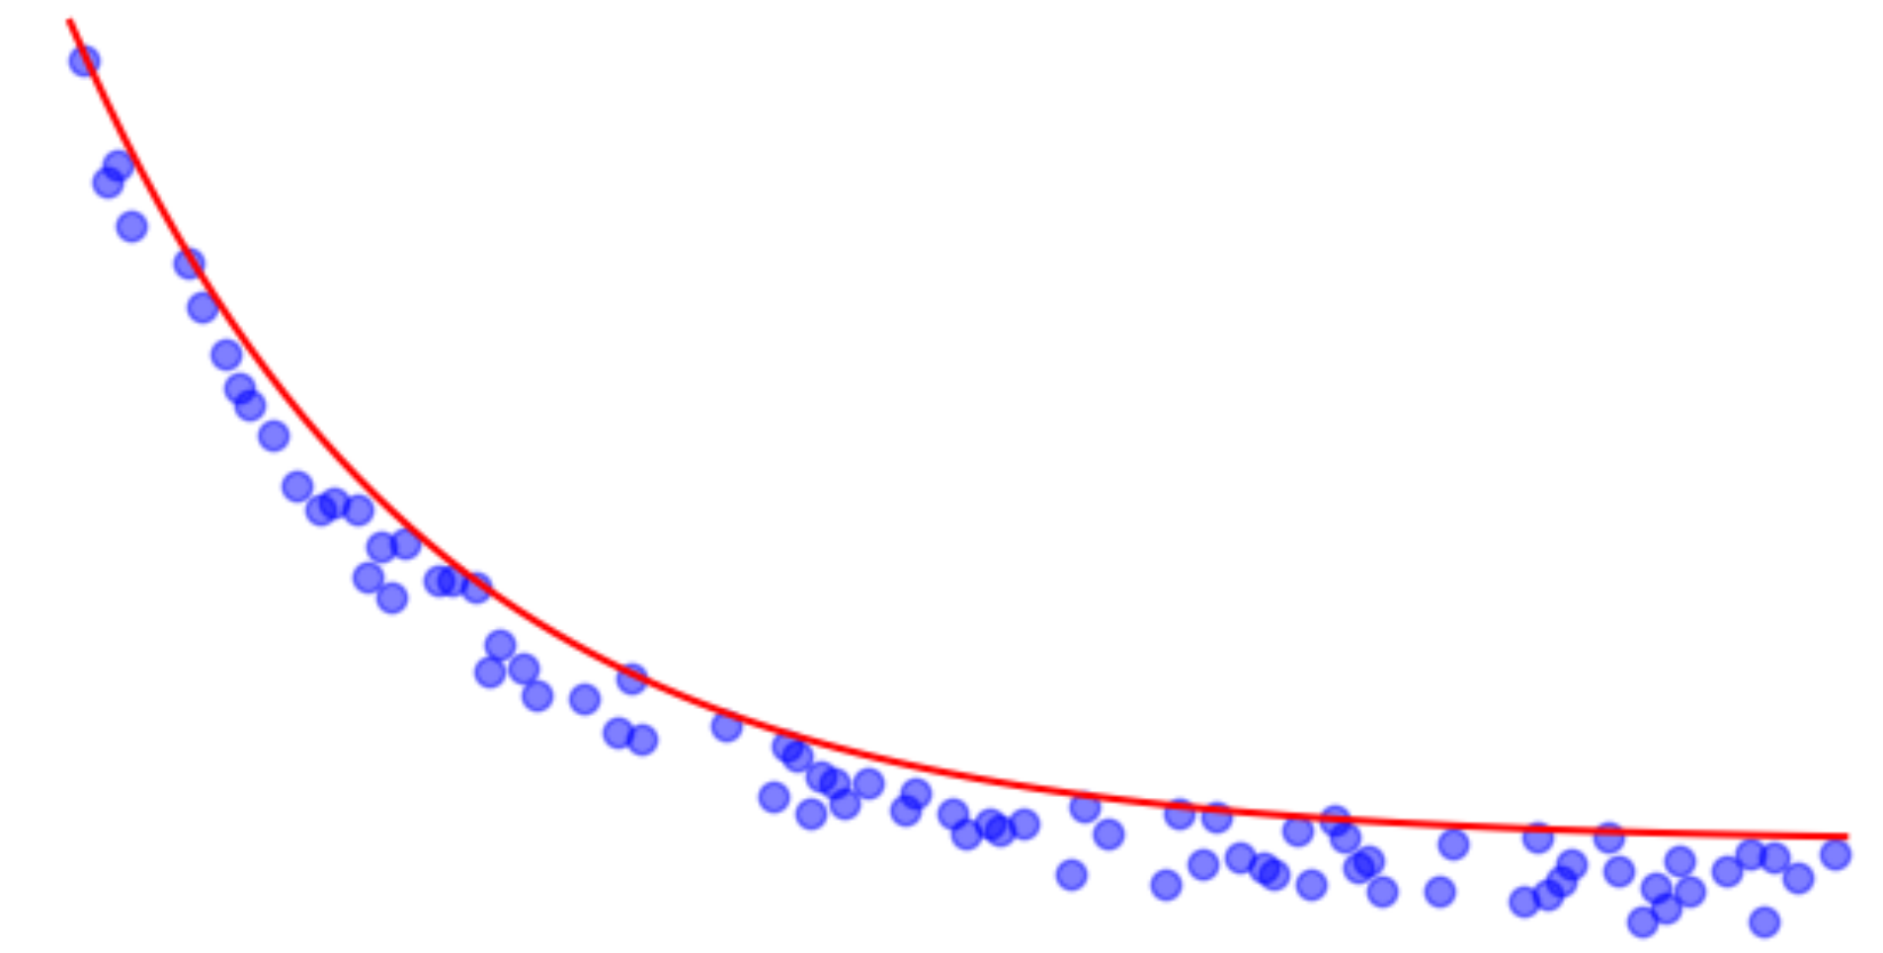
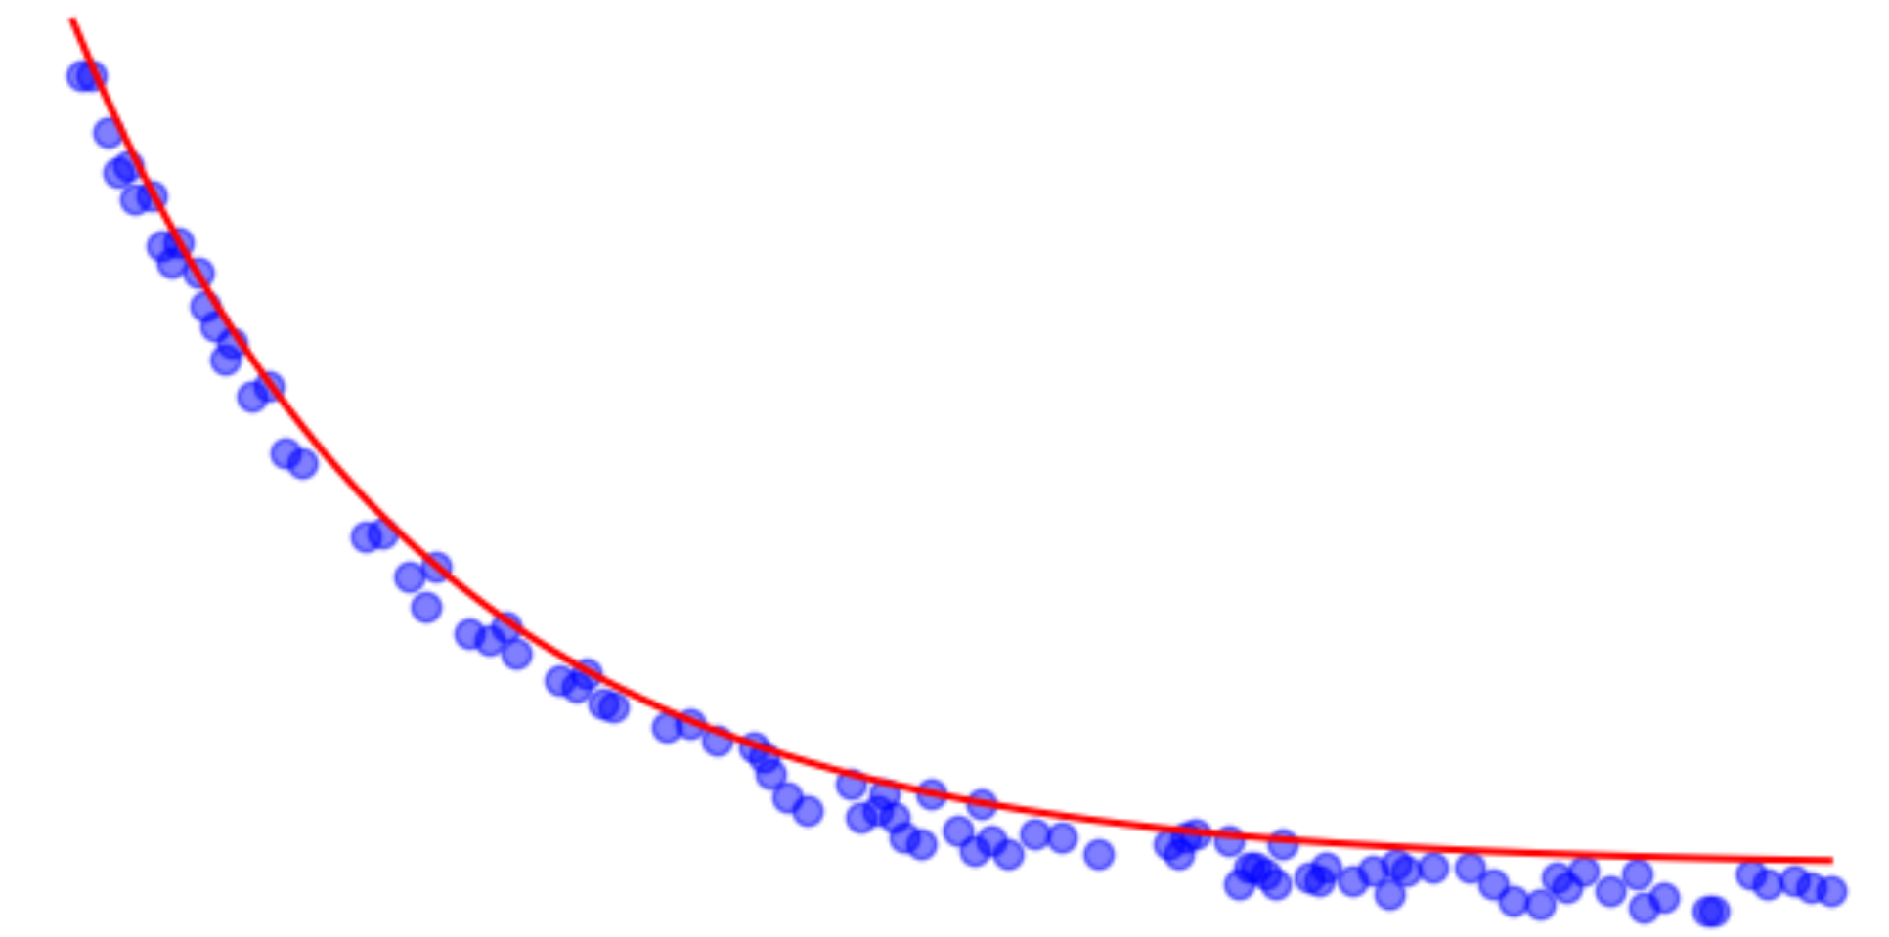
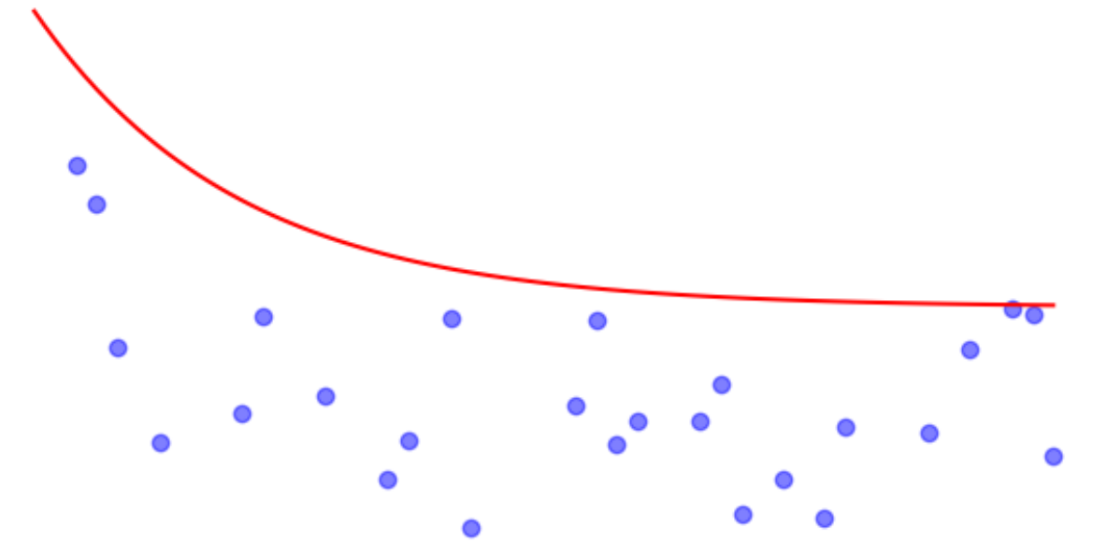
General Working of any Multi Objective Evolutionary algorithm
Iteration 2
Iteration 3
Iteration 4
Iteration 1
Iteration 100

Slide 46
Updates and Improvements

Slide 47
Feed full text
Final Output
Optimal Pareto Front
Single Solution Extraction from Pareto Front
Multi-Objective Evolutionary Computing Algorithm
Optimal Sentence Indices
[1,9,22,34,45,82,101,104]
Associated Extractive Summary

Slide 48
Single Solution Extraction Methods
Consensus
Largest Hypervolume
Topmost Coverage
Topmost redundancy reduction
Shortest Euclidean distance to ideal point
Shortest Manhattan distance to ideal point
Shortest Chebyshev distance to ideal point
Shortest Mahalanobis distance to ideal point
Shortest Chebyshev distance to all points
Shortest Manhattan distance to all points
Shortest Mahalanobis distance to all points
Shortest Euclidean distance to all points
Shortest Levenshtein distance to all points
Take the sentences suggested the most across all NDS archive members
Takes the member from the NDS archive that occupies the largest hypervolume(in our case area)
Take that NDS archive member that has the highest coverage value
Take that NDS archive member that has the highest redundancy_reduction value
Take that member that has the shortest Euclidean distance to (1,1)
Take that member that has the shortest Manhattan distance to (1,1)
Take that member that has the shortest Chebyshev distance to (1,1)
Take that member that has the shortest Mahalanobis distance to (1,1)
Take that member that has the shortest Chebyshev distance to all other NDS members
Take that member that has the shortest Manhattan distance to all other NDS members
Take that member that has the shortest Mahalanobis distance to all other NDS
Take that member that has the shortest Euclidean distance to all other NDS
Take that member that has the shortest Levenshtein distance to all other NDS

Slide 49
Topic Modelling using HDP
Hierarchical Dirichlet Process (HDP) is a non-parametric Bayesian method used for topic modeling.
It extends the Dirichlet Process (DP) to allow for an infinite number of mixture components, making it suitable for tasks where the number of topics is unknown or could potentially be very large.
In LDA, the no. of topics needed to be provided before hand, whereas this is not needed in HDP.

Slide 50
HDP Working and Structure
Sentences
HDP Model
Sentence to Topic Association
Sentences Embedded in Topic Space
 | Topic0 | Topic1 | Topic2 | Topic3
S0 | 0.72 | 0.61 | 0.07 | 0.52
S1 | 0.44 | 0.12 | 0.29 | 0.06
S2 | 0.90 | 0.75 | 0.63 | 0.8
S3 | 0.64 | 0.46 | 0.13 | 0.44
S4 | 0.04 | 0.56 | 0.37 | 0.75
Note that now the sentences are embedded in topic space(instead of term space). Here, the no. of topics is returned by HDP model.
Each sentence vector dimension shall equal no. of topics

Slide 51
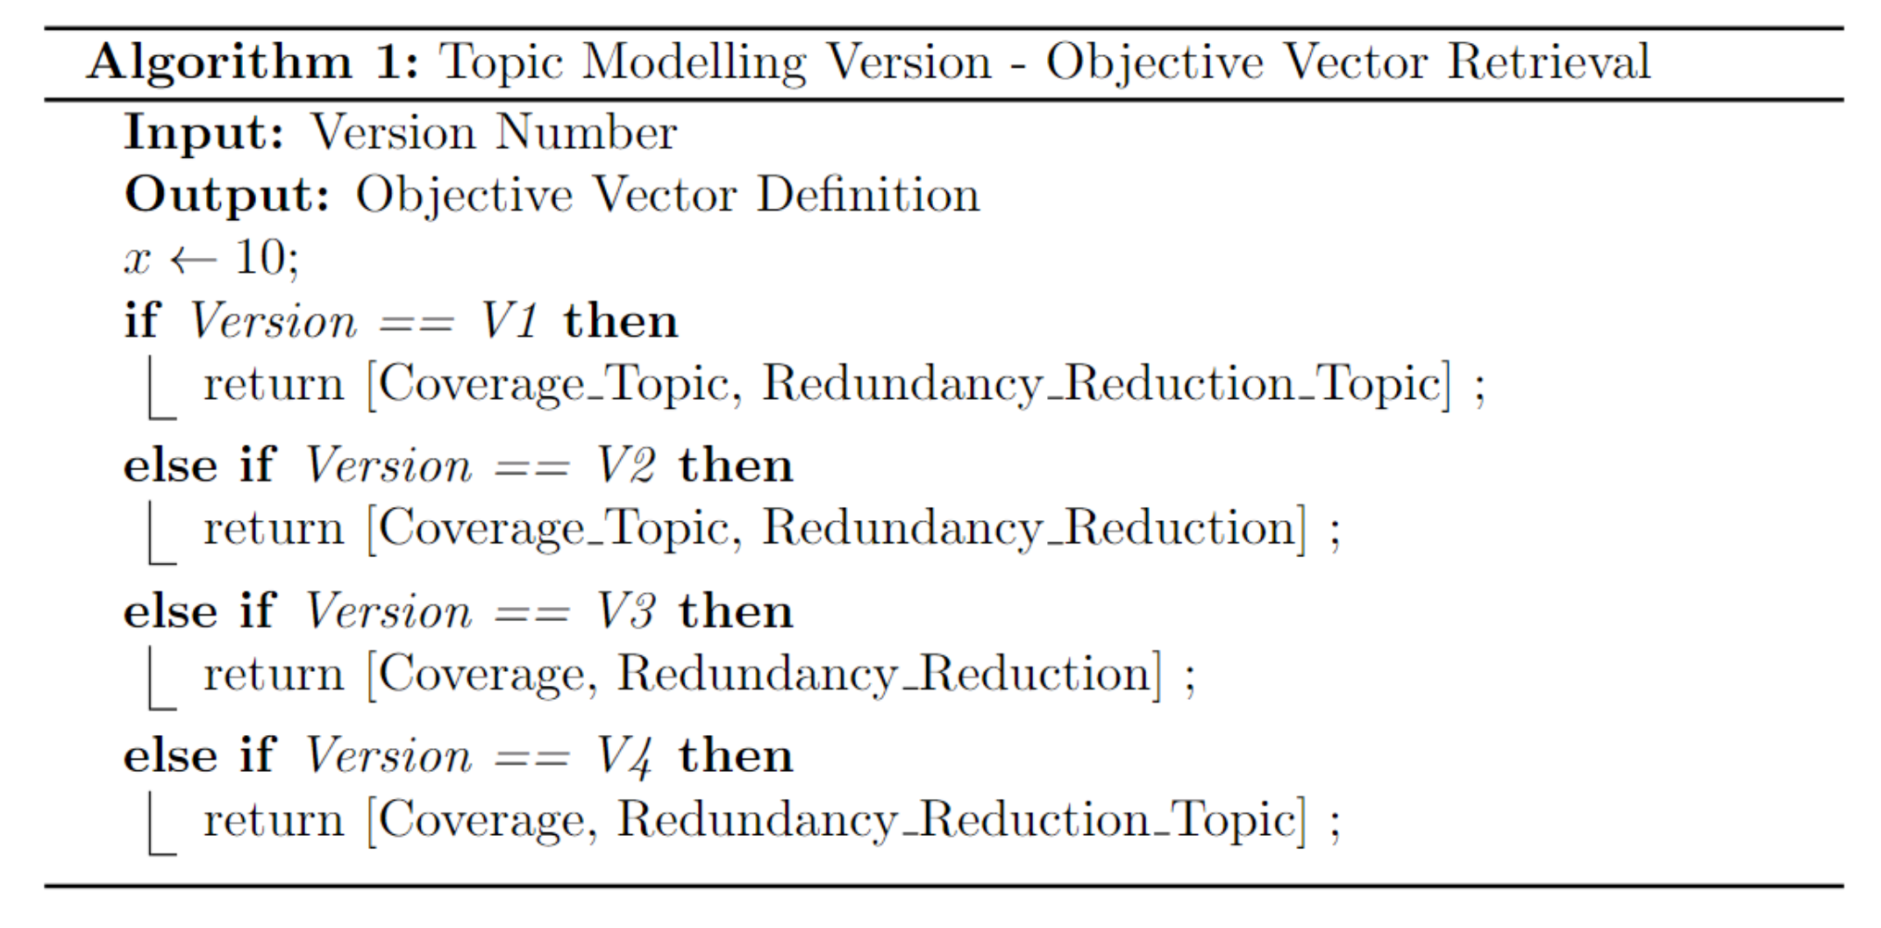
Topic Modelling Versions

Slide 52
Updates to Sentence Scoring Algorithm
TextRank is a graph-based algorithm for text summarization and keyword extraction, leveraging sentence relationships to determine importance.
LexRank, a variant of TextRank, further refines this approach by considering lexical similarity among sentences to improve summarization quality.
Graph based extractive text summarizer(GETS), uses cosine similarities on a graph sentence network and takes those sentences that cross a threshold.
We use TF_Scoring, LexRank, TextRank and GETS in a random manner, everytime we use sentence scoring during repair.

Slide 53
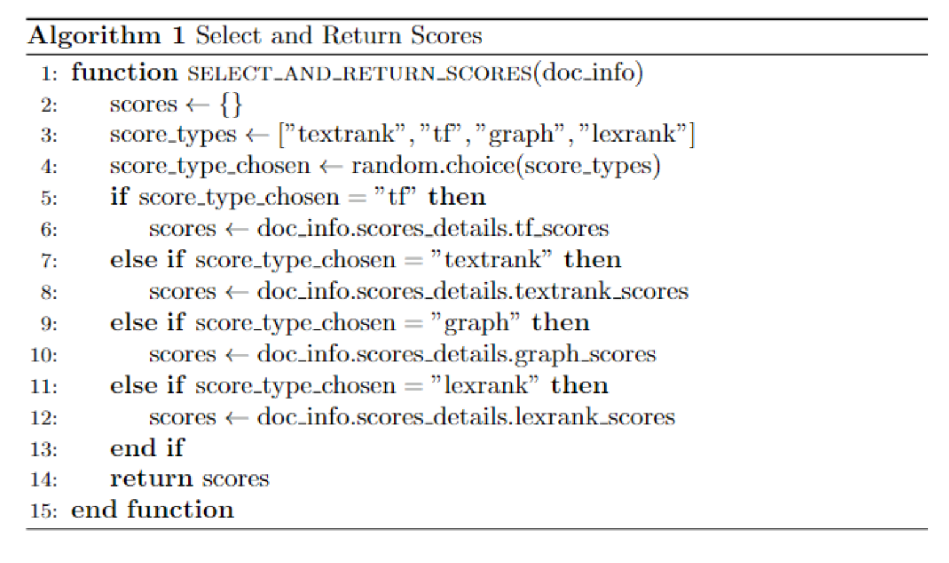
Updated Sentence Scoring Algorithm

Slide 54
Mutation Operator V2
In the naïve mutation operator(V1), we follow the operator suggested in Sanchez(base paper).
However, on reading other literature corresponding to multi objective optimization, we found that the NDS archive can be used in aiding the mutation operator to mutate better.
The NDS archive contains the best set of solutions up till this iteration and serves as a good guide for mutation.

Slide 55
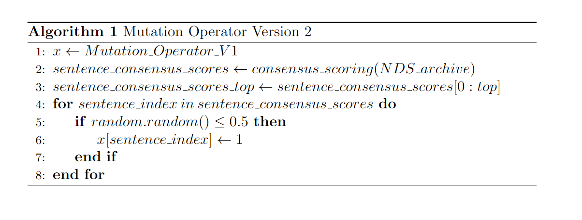
Mutation Operator V2-Algorithm

Slide 56
Brief Description of how V2 works
Here, we first mutate X using V1 mutation operator
Then, we get a consensus score by passing the current NDS archive
i.e Once the NDS archive has been passed it takes all the members and identifies which member has voted for which sentence
This results in a sentence_count dictionary
Then we sort the sentence counts in a descending manner, and take the top 10 voted sentences
We then use these voted sentences in a random manner as indicated in the algorithm previously stated

Slide 57
Working of V2
Descending Manner
NDS Archive
Sentence Vote Dict
Sentence Vote Dict
M1 [1,1,0,0,1]
S0 : 2
S4 : 3
M2 [0,1,1,1,1]
S1: 2
S0 : 2
M7 [1,0,0,0,0]
M8 [0,0,0,0,1]
S2 : 1
S1: 2
S3 : 1
S2 : 1
S4 : 3
S3 : 1

Slide 58
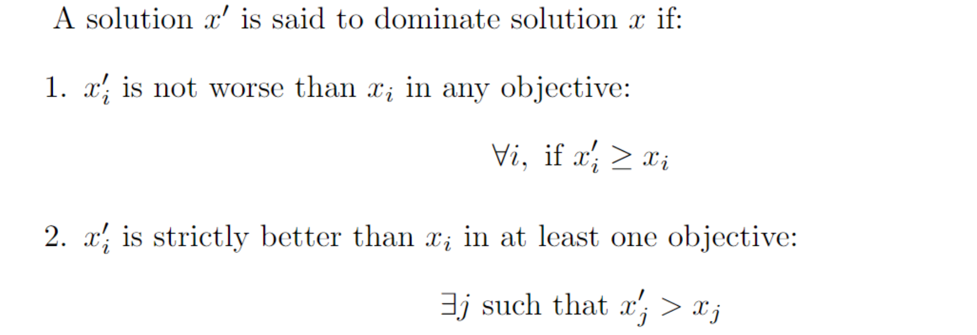
Domination

Slide 59
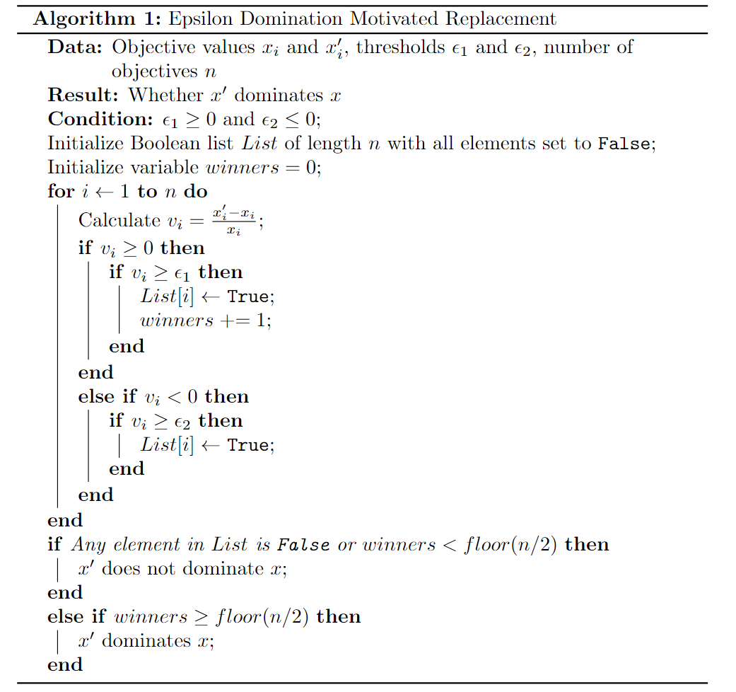
Epsilon Dominance Motivated Replacement
The variable winners is used to find the no. of winners in all the objectives
Here, a solution x’ can dominate x if it is :
Not facing a considerable loss > e2
Having a considerable improvement >e1
No. of improvement objectives(winners) > n/2

Slide 60
Brief Description
Here, we find the percentage change and then check its percentage improvement(+ve) or deterioration(-ve)
If the improvement > e1 or detoriation is >e2 (Where e1>=0 and e2<=0) then, it is accepted
Else it is not accepted
The core idea is that :
We need a minimum percentage improvement(e1) on certain objectives
But at the same time cannot lose more than a max percentage deterioration(e2)
If this is possible, then the solution is considered better/(e1,e2) dominates. Else it is not considered good for comprehensive exploration.

Slide 61
Ranking and Crowding Based Replacement
We incorporate this idea from NSGA and use it MOABC in a slightly modified format to see if this type of replacement criterion might be better
The algorithm is mentioned in the next slide

Slide 62
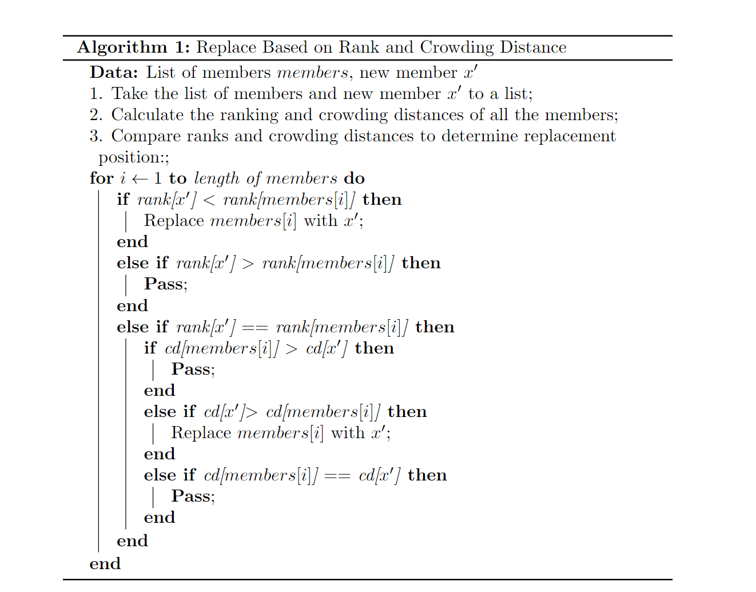
Do note that lower ranked solutions are closer to optimality than higher ranked solutions
Higher crowding distance solutions represent more variety and hence more preferred than lower crowding distance solutions

Slide 63
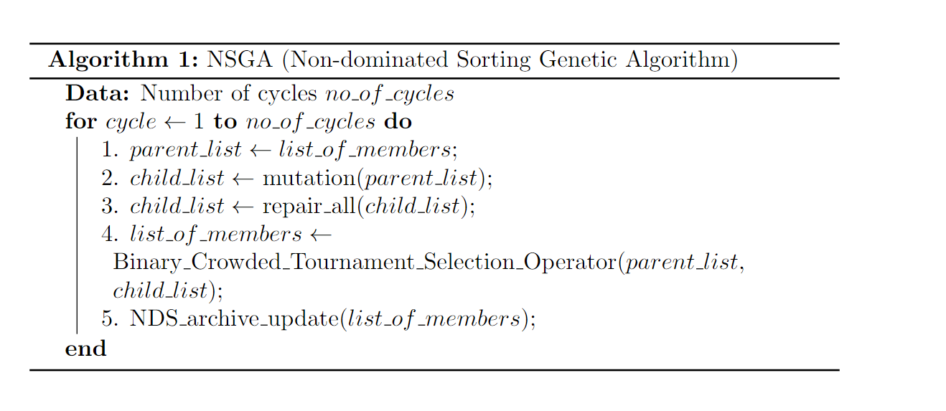
NSGA

Slide 64
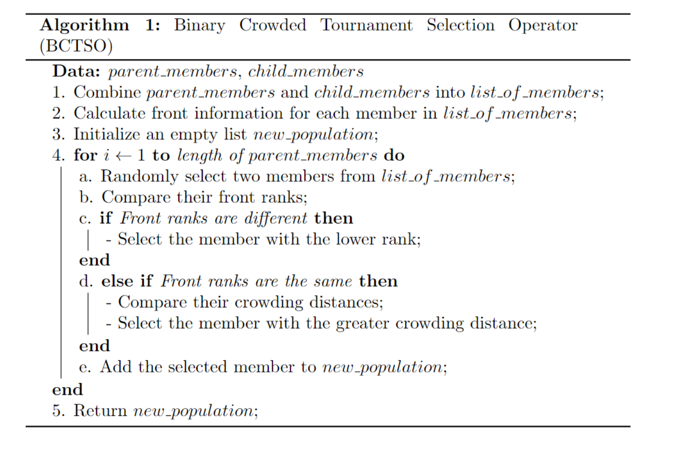
Binary Crowded Tournament Selection Operator
Basically, here we take any 2 members from the combination of parents and children(binary tournament)
Then we compare their ranks and crowding distances
Among the 2 whoever wins, enters into new_population
New population is returned

Slide 65
Results

Slide 66
Experiments
We shall conduct 5 experiments:
Exp1 : Mutation Operators : In this experiment, we shall compare the performance of the various mutation operators(V1 and V2)
Exp2 : MOABC vs NSGA : Here, we shall compare the performance of MOABC and NSGA, 2 state-of-the-art multi-objective optimization algorithms
Exp3 : Replacement Operators : We observe that the replacement operator in any MOEA is a crucial step. We compare some operators on performance.
Exp4 : Sentence Representation : We try to change the sentence representations and embedding and see if there is an improvement.
Exp5 : Topic Modelling : We compare the various versions of topic modelling proposed previously

Slide 67
Single Solution Extraction Methods Experiments
In the upcoming slides, we shall first perform each experiment and try to find which extraction method is the best to extract the solution from the pareto front.

Slide 68
Exp1 : Different Mutation Operator Versions
 | v1 |  |  | v2
Single Solution Extraction Method | Rouge-1 | Rouge-2 | Rouge-L | Rouge-1 | Rouge-2 | Rouge-L
Consensus | 0.488003 | 0.207657 | 0.24613 | 0.490004 | 0.206773 | 0.242533
Largest Hypervolume | 0.433383 | 0.131932 | 0.201392 | 0.442169 | 0.144581 | 0.215188
Topmost Coverage | 0.459804 | 0.178171 | 0.230284 | 0.462031 | 0.185829 | 0.235045
Topmost Redundancy Reduction | 0.425854 | 0.121665 | 0.195965 | 0.436459 | 0.137917 | 0.20899
Ideal Euclidean | 0.467883 | 0.172147 | 0.22317 | 0.477185 | 0.187835 | 0.230624
Ideal Manhattan | 0.450335 | 0.151914 | 0.217248 | 0.450239 | 0.157928 | 0.220122
Ideal Chebyshev | 0.475961 | 0.179695 | 0.230374 | 0.470444 | 0.178726 | 0.228513
Ideal Mahalanobis | 0.457092 | 0.158584 | 0.211604 | 0.472495 | 0.175473 | 0.227154
All Chebyshev | 0.468927 | 0.17297 | 0.225292 | 0.482124 | 0.189614 | 0.232476
All Manhattan | 0.467964 | 0.171004 | 0.223779 | 0.486161 | 0.193111 | 0.239116
All Mahalanobis | 0.46934 | 0.169296 | 0.227714 | 0.475477 | 0.177737 | 0.228766
All Euclidean | 0.467513 | 0.167787 | 0.223637 | 0.477436 | 0.182022 | 0.230812
All Levenshtein | 0.476481 | 0.185901 | 0.231284 | 0.488128 | 0.201269 | 0.239669

Slide 69
Exp2 : MOABC vs NSGA Comparison
 | MOABC |  |  | NSGA
Single Solution Extraction Method | Rouge-1 | Rouge-2 | Rouge-L | Rouge-1 | Rouge-2 | Rouge-L
Consensus | 0.488003 | 0.207657 | 0.24613 | 0.477775 | 0.191733 | 0.238035
Largest Hypervolume | 0.433383 | 0.131932 | 0.201392 | 0.444965 | 0.145234 | 0.213816
Topmost Coverage | 0.459804 | 0.178171 | 0.230284 | 0.46325 | 0.178817 | 0.227706
Topmost Redundancy Reduction | 0.425854 | 0.121665 | 0.195965 | 0.44206 | 0.141879 | 0.211273
Ideal Euclidean | 0.467883 | 0.172147 | 0.22317 | 0.461458 | 0.162065 | 0.223547
Ideal Manhattan | 0.450335 | 0.151914 | 0.217248 | 0.462307 | 0.168243 | 0.224203
Ideal Chebyshev | 0.475961 | 0.179695 | 0.230374 | 0.475285 | 0.18886 | 0.239015
Ideal Mahalanobis | 0.457092 | 0.158584 | 0.211604 | 0.460684 | 0.165726 | 0.225548
All Chebyshev | 0.468927 | 0.17297 | 0.225292 | 0.464569 | 0.167418 | 0.216745
All Manhattan | 0.467964 | 0.171004 | 0.223779 | 0.466226 | 0.170115 | 0.21807
All Mahalanobis | 0.46934 | 0.169296 | 0.227714 | 0.465786 | 0.169212 | 0.219253
All Euclidean | 0.467513 | 0.167787 | 0.223637 | 0.463335 | 0.166639 | 0.219111
All Levenshtein | 0.476481 | 0.185901 | 0.231284 | 0.472801 | 0.18274 | 0.23488

Slide 70
Exp3 : Different Replacement Operator Versions
 | Dominate |  |  | EpsilonDominate |  |  | RCR
Single Solution Extraction Method | Rouge-1 | Rouge-2 | Rouge-L | Rouge-1 | Rouge-2 | Rouge-L | Rouge-1 | Rouge-2 | Rouge-L
Consensus | 0.487442 | 0.205303 | 0.241226 | 0.491977 | 0.217469 | 0.253821 | 0.492276 | 0.210495 | 0.247404
Largest Hypervolume | 0.432769 | 0.12633 | 0.195346 | 0.433308 | 0.13352 | 0.201359 | 0.437531 | 0.133266 | 0.20658
Topmost Coverage | 0.456353 | 0.174335 | 0.227231 | 0.453223 | 0.170191 | 0.225285 | 0.466758 | 0.190847 | 0.232288
Topmost Redundancy Reduction | 0.4276 | 0.123843 | 0.197399 | 0.429202 | 0.128493 | 0.199728 | 0.431921 | 0.12836 | 0.202126
Ideal Euclidean | 0.460974 | 0.16348 | 0.218466 | 0.457247 | 0.155786 | 0.215846 | 0.461275 | 0.161244 | 0.224303
Ideal Manhattan | 0.446017 | 0.149977 | 0.205254 | 0.444524 | 0.149592 | 0.208755 | 0.453208 | 0.161226 | 0.219934
Ideal Chebyshev | 0.481413 | 0.191841 | 0.240614 | 0.474248 | 0.179686 | 0.235874 | 0.477146 | 0.186126 | 0.236002
Ideal Mahalanobis | 0.455925 | 0.154982 | 0.214323 | 0.452878 | 0.146942 | 0.208262 | 0.45667 | 0.153117 | 0.216118
All Chebyshev | 0.479972 | 0.190442 | 0.236587 | 0.474176 | 0.17514 | 0.22242 | 0.47804 | 0.185392 | 0.2343
All Manhattan | 0.483602 | 0.197549 | 0.239999 | 0.475086 | 0.181089 | 0.228752 | 0.474207 | 0.179213 | 0.227666
All Mahalanobis | 0.473976 | 0.180781 | 0.231238 | 0.475638 | 0.189074 | 0.231246 | 0.481706 | 0.183105 | 0.232318
All Euclidean | 0.472279 | 0.177632 | 0.226525 | 0.472027 | 0.179416 | 0.226239 | 0.482911 | 0.188737 | 0.235976
All Levenshtein | 0.486761 | 0.201122 | 0.243859 | 0.478519 | 0.188146 | 0.236702 | 0.483564 | 0.194652 | 0.236882

Slide 71
Exp4 : Term frequency vs SBERT Sentence Representation
 | TFISF |  |  | SBERT
Single Solution Extraction Method | Rouge-1 | Rouge-2 | Rouge-L | Rouge-1 | Rouge-2 | Rouge-L
Consensus | 0.488003 | 0.207657 | 0.24613 | 0.461448 | 0.187128 | 0.227898
Largest Hypervolume | 0.433383 | 0.131932 | 0.201392 | 0.432274 | 0.135638 | 0.199969
Topmost Coverage | 0.459804 | 0.178171 | 0.230284 | 0.435896 | 0.152273 | 0.214098
Topmost Redundancy Reduction | 0.425854 | 0.121665 | 0.195965 | 0.429873 | 0.130904 | 0.198952
Ideal Euclidean | 0.467883 | 0.172147 | 0.22317 | 0.435168 | 0.135389 | 0.202526
Ideal Manhattan | 0.450335 | 0.151914 | 0.217248 | 0.431005 | 0.136156 | 0.199472
Ideal Chebyshev | 0.475961 | 0.179695 | 0.230374 | 0.445909 | 0.141701 | 0.207671
Ideal Mahalanobis | 0.457092 | 0.158584 | 0.211604 | 0.438702 | 0.145521 | 0.204281
All Chebyshev | 0.468927 | 0.17297 | 0.225292 | 0.451782 | 0.160861 | 0.218211
All Manhattan | 0.467964 | 0.171004 | 0.223779 | 0.446752 | 0.155868 | 0.216721
All Mahalanobis | 0.46934 | 0.169296 | 0.227714 | 0.448955 | 0.157877 | 0.220785
All Euclidean | 0.467513 | 0.167787 | 0.223637 | 0.44911 | 0.157663 | 0.218263
All Levenshtein | 0.476481 | 0.185901 | 0.231284 | 0.449796 | 0.157097 | 0.215789

Slide 72
Exp5 : Different Topic modelling Versions
 | v1 |  |  | v2 |  |  | v3 |  |  | v4
Single Solution Extraction Method | Rouge-1 | Rouge-2 | Rouge-L | Rouge-1 | Rouge-2 | Rouge-L | Rouge-1 | Rouge-2 | Rouge-L | Rouge-1 | Rouge-2 | Rouge-L
Consensus | 0.456564 | 0.179032 | 0.24228 | 0.461272 | 0.172836 | 0.231789 | 0.488003 | 0.207657 | 0.24613 | 0.462249 | 0.17939 | 0.221719
Largest Hypervolume | 0.455179 | 0.163846 | 0.221929 | 0.44691 | 0.146533 | 0.209237 | 0.433383 | 0.131932 | 0.201392 | 0.454155 | 0.160589 | 0.208676
Topmost Coverage | 0.458444 | 0.183214 | 0.24029 | 0.455767 | 0.173598 | 0.227677 | 0.459804 | 0.178171 | 0.230284 | 0.459374 | 0.184019 | 0.234319
Topmost Redundancy Reduction | 0.423967 | 0.128389 | 0.199834 | 0.42323 | 0.110758 | 0.189627 | 0.425854 | 0.121665 | 0.195965 | 0.435521 | 0.140511 | 0.209492
Ideal Euclidean | 0.450201 | 0.16045 | 0.217946 | 0.447788 | 0.147693 | 0.211911 | 0.467883 | 0.172147 | 0.22317 | 0.46495 | 0.174729 | 0.224421
Ideal Manhattan | 0.447103 | 0.153131 | 0.210197 | 0.433143 | 0.131261 | 0.200671 | 0.450335 | 0.151914 | 0.217248 | 0.46389 | 0.174318 | 0.2201
Ideal Chebyshev | 0.456275 | 0.165886 | 0.228742 | 0.455947 | 0.159248 | 0.225121 | 0.475961 | 0.179695 | 0.230374 | 0.458064 | 0.162217 | 0.217375
Ideal Mahalanobis | 0.457602 | 0.180554 | 0.235365 | 0.452946 | 0.160138 | 0.220601 | 0.457092 | 0.158584 | 0.211604 | 0.469698 | 0.183519 | 0.231863
All Chebyshev | 0.45682 | 0.168102 | 0.229081 | 0.456618 | 0.157103 | 0.227654 | 0.468927 | 0.17297 | 0.225292 | 0.466811 | 0.182602 | 0.229629
All Manhattan | 0.457582 | 0.169622 | 0.226216 | 0.458996 | 0.162972 | 0.230868 | 0.467964 | 0.171004 | 0.223779 | 0.471193 | 0.186826 | 0.23071
All Mahalanobis | 0.462706 | 0.178862 | 0.232693 | 0.462051 | 0.170484 | 0.233751 | 0.46934 | 0.169296 | 0.227714 | 0.476038 | 0.194277 | 0.234492
All Euclidean | 0.458757 | 0.169185 | 0.231581 | 0.457684 | 0.160296 | 0.228498 | 0.467513 | 0.167787 | 0.223637 | 0.474507 | 0.190195 | 0.231441
All Levenshtein | 0.452001 | 0.160997 | 0.223304 | 0.456291 | 0.159638 | 0.220572 | 0.476481 | 0.185901 | 0.231284 | 0.454776 | 0.16342 | 0.217417

Slide 73
Inference
We find that overall, “consensus” single solution extraction method from pareto front is the best method as it reflects at a higher ROUGE score in comparison to other methods.

Slide 74
Algorithmic Experiments and Comparison
We have decided from the previous slides, that “consensus” method of extraction is the best
Hence, we shall use this in any of the further upcoming experiments
Now, we have a total of 9 algorithms spread across 5 experiments
These algorithms are listed and summarized in the next slide
The ROUGE scores obtained w.r.t each document in the dataset is reported

Slide 75
Algorithms
 | Algorithm Name | Salient Features
1 | V1-Topic | Coverage and Redundancy Reduction are both in topic space
2 | V2-Topic | Coverage in topic space, Redundancy Reduction in term space
3 | V3-Topic | Coverage and Redundancy Reduction in term space Note that in future slides V3-Topic = TFISF = v1Mutation = MOABC They all refer to the same algorithm
4 | V4-Topic | Coverage in term space, Redundancy Reduction in topic space
5 | With-SBERT | Sentence Embeddings in SBERT Transformer space
6 | eDominate | Using the epsilon domination criteria for replacement
7 | RCR | Using the Ranking and Crowding criteria for replacement
8 | NSGA | NSGA algorithm implementation
9 | V2-Mutation | Using the NDS archive to mutate better

Slide 76
Exp1 : Different Mutation Operator Versions
 | v1 |  |  | v2
Document ID | Rouge-1 | Rouge2 | Rouge-L | Rouge-1 | Rouge2 | Rouge-L
d061j | 0.551657 | 0.260877 | 0.272444 | 0.570783 | 0.298663 | 0.285493
d062j | 0.431267 | 0.152089 | 0.199343 | 0.408765 | 0.093617 | 0.180944
d063j | 0.451138 | 0.202795 | 0.216988 | 0.454979 | 0.21975 | 0.211262
d064j | 0.425557 | 0.174111 | 0.245297 | 0.436432 | 0.170562 | 0.232912
d065j | 0.519318 | 0.309747 | 0.359557 | 0.513404 | 0.299694 | 0.351334
d066j | 0.4142 | 0.071273 | 0.17564 | 0.425344 | 0.070964 | 0.180189
d067f | 0.523673 | 0.232305 | 0.267432 | 0.531485 | 0.233507 | 0.253942
d068f | 0.619635 | 0.365537 | 0.309796 | 0.605184 | 0.344679 | 0.284687
d069f | 0.453829 | 0.105145 | 0.186789 | 0.447611 | 0.102435 | 0.182829
d070f | 0.489754 | 0.202696 | 0.228016 | 0.506052 | 0.233865 | 0.261737
 | 0.488003 | 0.207657 | 0.24613 | 0.490004 | 0.206773 | 0.242533

Slide 77
Exp2 : MOABC vs NSGA Comparison
 | MOABC |  |  | NSGA
Document ID | Rouge-1 | Rouge-2 | Rouge-L | Rouge-1 | Rouge-2 | Rouge-L
d061j | 0.551657 | 0.260877 | 0.272444 | 0.5327 | 0.260506 | 0.2702
d062j | 0.431267 | 0.152089 | 0.199343 | 0.421115 | 0.122121 | 0.196113
d063j | 0.451138 | 0.202795 | 0.216988 | 0.43643 | 0.17574 | 0.201363
d064j | 0.425557 | 0.174111 | 0.245297 | 0.410522 | 0.139943 | 0.20208
d065j | 0.519318 | 0.309747 | 0.359557 | 0.478116 | 0.247531 | 0.320793
d066j | 0.4142 | 0.071273 | 0.17564 | 0.419623 | 0.077725 | 0.183548
d067f | 0.523673 | 0.232305 | 0.267432 | 0.53563 | 0.264299 | 0.2798
d068f | 0.619635 | 0.365537 | 0.309796 | 0.597453 | 0.328951 | 0.319857
d069f | 0.453829 | 0.105145 | 0.186789 | 0.458077 | 0.102865 | 0.184673
d070f | 0.489754 | 0.202696 | 0.228016 | 0.488088 | 0.197652 | 0.22192
 | 0.488003 | 0.207657 | 0.24613 | 0.477775 | 0.191733 | 0.238035

Slide 78
Exp3 : Different Replacement Operator Versions
 | Dominate |  |  | EpsilonDominate |  |  | RCR
Document ID | Rouge-1 | Rouge-2 | Rouge-L | Rouge-1 | Rouge-2 | Rouge-L | Rouge-1 | Rouge-2 | Rouge-L
d061j | 0.55272 | 0.29005 | 0.27781 | 0.55400 | 0.28680 | 0.28250 | 0.58071 | 0.34048 | 0.31546
d062j | 0.44144 | 0.16579 | 0.21115 | 0.41913 | 0.12400 | 0.18274 | 0.46136 | 0.18850 | 0.22598
d063j | 0.45703 | 0.20889 | 0.19440 | 0.46017 | 0.22777 | 0.21704 | 0.45607 | 0.22332 | 0.21999
d064j | 0.44099 | 0.17967 | 0.24330 | 0.43176 | 0.15366 | 0.22258 | 0.44050 | 0.17420 | 0.25695
d065j | 0.49562 | 0.28173 | 0.34960 | 0.51293 | 0.28782 | 0.34046 | 0.51438 | 0.30188 | 0.35057
d066j | 0.41092 | 0.06859 | 0.17019 | 0.42033 | 0.07375 | 0.18205 | 0.42602 | 0.06847 | 0.17132
d067f | 0.51880 | 0.21419 | 0.25537 | 0.53099 | 0.25073 | 0.26578 | 0.54257 | 0.24548 | 0.29174
d068f | 0.60606 | 0.32829 | 0.28381 | 0.63537 | 0.38061 | 0.31271 | 0.59958 | 0.32943 | 0.28441
d069f | 0.45432 | 0.10258 | 0.18393 | 0.45446 | 0.10191 | 0.18345 | 0.45306 | 0.10285 | 0.18650
d070f | 0.49652 | 0.21324 | 0.24272 | 0.49231 | 0.20027 | 0.23285 | 0.48330 | 0.20165 | 0.22218
 | 0.48744 | 0.20530 | 0.24123 | 0.49115 | 0.20873 | 0.24222 | 0.49575 | 0.21763 | 0.25251

Slide 79
Exp4 : Term frequency vs SBERT Sentence Representation
 | TFISF |  |  | SBERT
Document ID | Rouge-1 | Rouge-2 | Rouge-L | Rouge-1 | Rouge-2 | Rouge-L
d061j | 0.551657 | 0.260877 | 0.272444 | 0.540018 | 0.299693 | 0.356535
d062j | 0.431267 | 0.152089 | 0.199343 | 0.385774 | 0.070138 | 0.168506
d063j | 0.451138 | 0.202795 | 0.216988 | 0.425208 | 0.146583 | 0.170417
d064j | 0.425557 | 0.174111 | 0.245297 | 0.459097 | 0.195037 | 0.265027
d065j | 0.519318 | 0.309747 | 0.359557 | 0.464201 | 0.214963 | 0.251056
d066j | 0.4142 | 0.071273 | 0.17564 | 0.482584 | 0.239276 | 0.306825
d067f | 0.523673 | 0.232305 | 0.267432 | 0.476661 | 0.226256 | 0.191814
d068f | 0.619635 | 0.365537 | 0.309796 | 0.451438 | 0.146679 | 0.179315
d069f | 0.453829 | 0.105145 | 0.186789 | 0.458764 | 0.195129 | 0.192586
d070f | 0.489754 | 0.202696 | 0.228016 | 0.470736 | 0.137523 | 0.196902
 | 0.488003 | 0.207657 | 0.24613 | 0.461448 | 0.187128 | 0.227898

Slide 80
Exp5 : Different Topic modelling Versions
 | v1 |  |  | v2 |  |  | v3 |  |  | v4
Document ID | v1 R1 | v1 R2 | v1 RL | v2 R1 | v2 R2 | v2 RL | v3 R1 | v3 R2 | v3 RL | v4 R1 | v4 R2 | v4 RL
d061j | 0.490855 | 0.200422 | 0.256568 | 0.480962 | 0.177603 | 0.239983 | 0.551657 | 0.260877 | 0.272444 | 0.554496 | 0.327477 | 0.304413
d062j | 0.405463 | 0.109369 | 0.198901 | 0.42615 | 0.121244 | 0.172391 | 0.431267 | 0.152089 | 0.199343 | 0.414817 | 0.111445 | 0.200867
d063j | 0.422723 | 0.161335 | 0.209004 | 0.428155 | 0.142192 | 0.197412 | 0.451138 | 0.202795 | 0.216988 | 0.472572 | 0.220135 | 0.204916
d064j | 0.404394 | 0.126168 | 0.181489 | 0.426592 | 0.146874 | 0.223509 | 0.425557 | 0.174111 | 0.245297 | 0.389721 | 0.121259 | 0.173326
d065j | 0.453827 | 0.197573 | 0.266948 | 0.491439 | 0.227168 | 0.266563 | 0.519318 | 0.309747 | 0.359557 | 0.422357 | 0.157846 | 0.239523
d066j | 0.409426 | 0.097689 | 0.208448 | 0.405764 | 0.124247 | 0.205008 | 0.4142 | 0.071273 | 0.17564 | 0.413225 | 0.076971 | 0.178291
d067f | 0.495544 | 0.209356 | 0.25398 | 0.517685 | 0.255226 | 0.287039 | 0.523673 | 0.232305 | 0.267432 | 0.531238 | 0.281905 | 0.264046
d068f | 0.582364 | 0.344546 | 0.371033 | 0.528717 | 0.258819 | 0.309875 | 0.619635 | 0.365537 | 0.309796 | 0.536354 | 0.229338 | 0.233252
d069f | 0.427792 | 0.116045 | 0.192514 | 0.443475 | 0.101383 | 0.18917 | 0.453829 | 0.105145 | 0.186789 | 0.43255 | 0.10499 | 0.199008
d070f | 0.473253 | 0.227822 | 0.283909 | 0.463782 | 0.173601 | 0.226942 | 0.489754 | 0.202696 | 0.228016 | 0.455156 | 0.162538 | 0.219546
 | 0.456564 | 0.179032 | 0.24228 | 0.461272 | 0.172836 | 0.231789 | 0.488003 | 0.207657 | 0.24613 | 0.462249 | 0.17939 | 0.221719

Slide 81
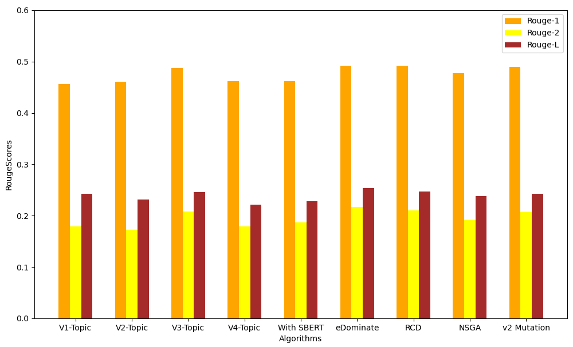
 | Rouge-1 | Rouge-2 | Rouge-L
V1-Topic | 0.456564 | 0.179032 | 0.24228
V2-Topic | 0.461272 | 0.172836 | 0.231789
V3-Topic | 0.488003 | 0.207657 | 0.24613
V4-Topic | 0.462249 | 0.17939 | 0.221719
With-SBERT | 0.461448 | 0.187128 | 0.227898
eDominate | 0.49115 | 0.20873 | 0.24222
RCR | 0.49575 | 0.21763 | 0.25251
NSGA | 0.477775 | 0.191733 | 0.238035
V2-Mutation | 0.490004 | 0.206773 | 0.242533

Slide 82
Contemporary Methods Comparison
 | Rouge-1 | Rouge-2
COSUM | 0.49083 | 0.23092
ESDS-GHS-GLO | 0.47903 | 0.22142
MA-SingleDocSum | 0.48280 | 0.22840
DE | 0.46694 | 0.12368
UnifiedRank | 0.48487 | 0.21462
FEOM | 0.46575 | 0.12490
NetSum | 0.44963 | 0.11167
CRF | 0.44006 | 0.10924
QSC | 0.44865 | 0.18766
SVM | 0.43235 | 0.10867
Manifold Ranking | 0.43235 | 0.10677
NN-SE | 0.47400 | 0.23200
SummmaRuNNer | 0.45400 | 0.23900
eDominate | 0.49115 | 0.20873
v2-Mutation | 0.490004 | 0.206773
v3-Topic | 0.488003 | 0.207657
RCR | 0.49575 | 0.21763
We find that our newly proposed methods have slightly better ROUGE-1 scores than the methods proposed previously in literature.
However, in terms of ROUGE-2, we underperform w.r.t the summarizer model – SummmaRunNNer

Slide 83
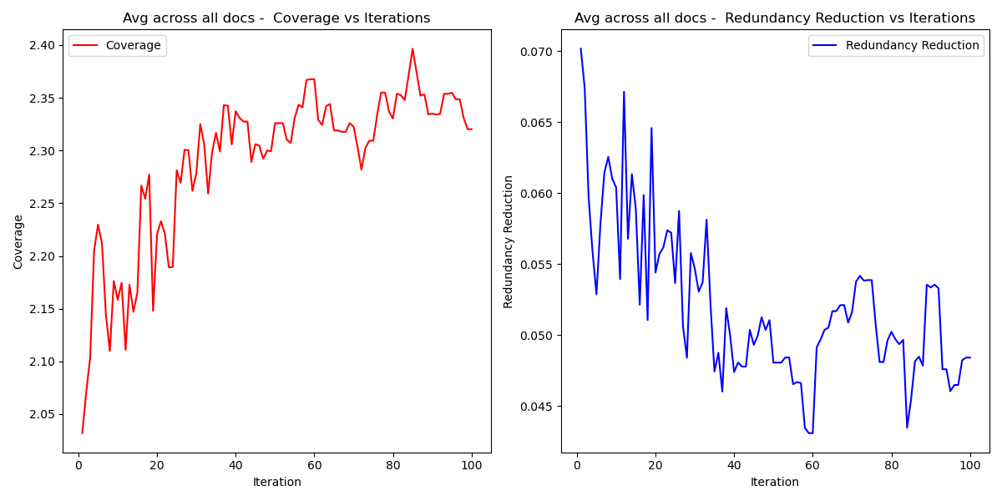
Objective Value trend across iterations
We observe that as iterations proceed, the coverage objective value increases and the redundancy reduction objective decreases, indicating that they are indeed conflicting objectives.

Slide 84
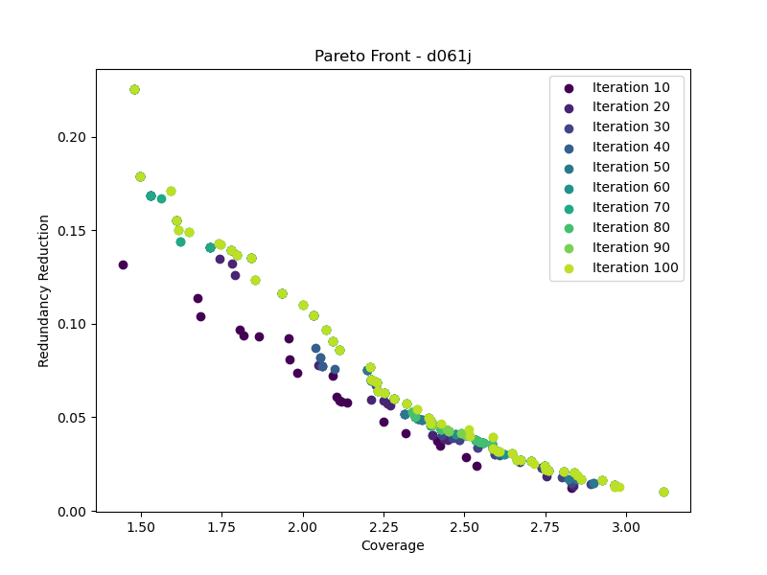
Pareto Front trend across iterations
We observe that as iteration proceed, the pareto front(obtained from the NDS archive) forms the optimal pareto front by iteration 100.

Slide 85
Datasets and Code Outputs

Slide 86

Dataset – DUC 2002
https://www-nlpir.nist.gov/projects/duc/guidelines/2002.html

Slide 87
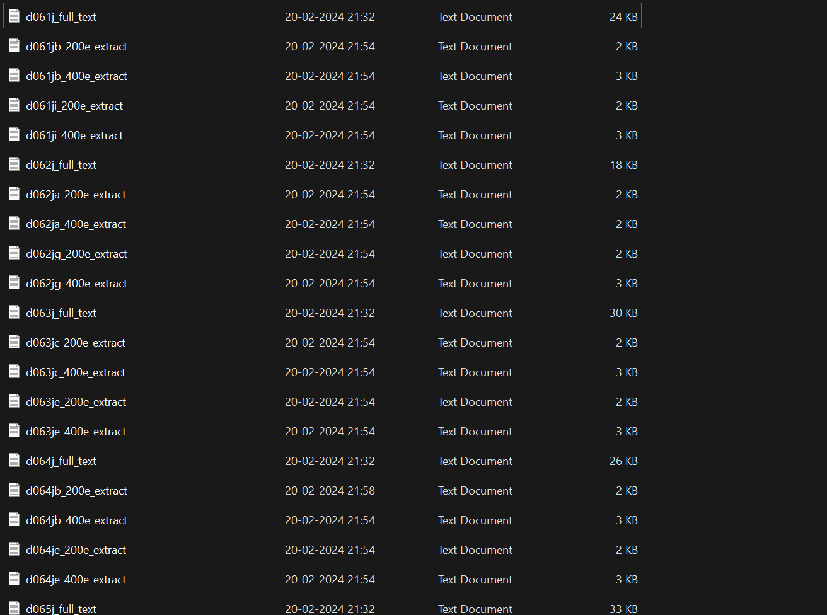
Sample Directory of Files
Full Text – The full text containing all sentences
d061j-Document id
200e-200 word extract
400e-400 word extract

Slide 88
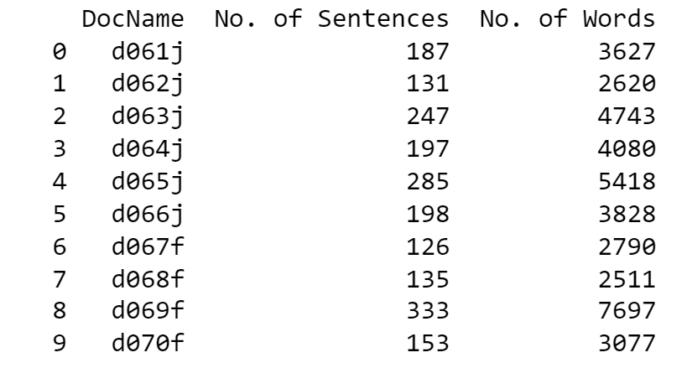
Dataset Information

Slide 89
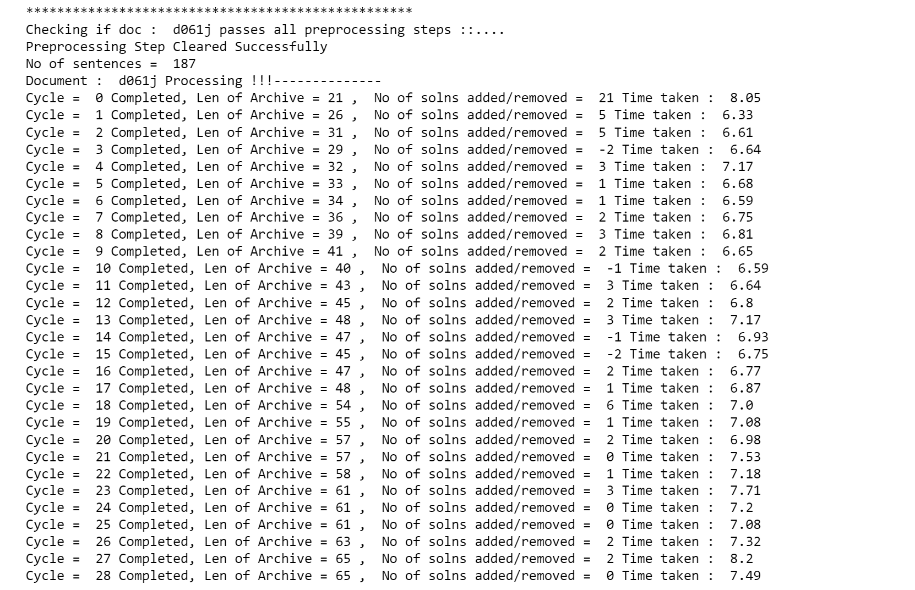
Sample Run

Slide 90

Sample Output

Slide 91

Sample Text File that logs and saves all details during Run

Slide 92
Sample Output
Hurricane Gilbert swept toward the Dominican Republic Sunday, and the Civil Defense alerted its heavily populated south coast to prepare for high winds, heavy rains and high seas. The storm was approaching from the southeast with sustained winds of 75 mph gusting to 92 mph. "There is no need for alarm," Civil Defense Director Eugenio Cabral said in a television alert shortly before midnight Saturday. Cabral said residents of the province of Barahona should closely follow Gilbert's movement. An estimated 100,000 people live in the province, including 70,000 in the city of Barahona, about 125 miles west of Santo Domingo. Tropical Storm Gilbert formed in the eastern Caribbean and strengthened into a hurricane Saturday night. The National Hurricane Center in Miami reported its position at 2 a.m. Sunday at latitude 16.1 north, longitude 67.5 west, about 140 miles south of Ponce, Puerto Rico, and 200 miles southeast of Santo Domingo. The National Weather Service in San Juan, Puerto Rico, said Gilbert was moving westward at 15 mph with a "broad area of cloudiness and heavy weather" rotating around the center of the storm. The weather service issued a flash flood watch for Puerto Rico and the Virgin Islands until at least 6 p.m. Sunday. Strong winds associated with the Gilbert brought coastal flooding, strong southeast winds and up to 12 feet feet to Puerto Rico's south coast. There were no reports of casualties. San Juan, on the north coast, had heavy rains and gusts Saturday, but they subsided during the night. On Saturday, Hurricane Florence was downgraded to a tropical storm and its remnants pushed inland from the U.S. Gulf Coast. Residents returned home, happy to find little damage from 80 mph winds and sheets of rain. Florence, the sixth named storm of the 1988 Atlantic storm season, was the second hurricane. The first, Debby, reached minimal hurricane strength briefly before hitting the Mexican coast last month. Hurricane Gilbert, packing 110 mph winds and torrential rain, moved over this capital city today after skirting Puerto Rico, Haiti and the Dominican Republic. There were no immediate reports of casualties. Telephone communications were affected. "Right now it's actually moving over Jamaica," said Bob Sheets, director of the National Hurricane Center in Miami. "We've already had reports of 110 mph winds on the eastern tip. "It looks like the eye is going to move lengthwise across that island, and they're going to bear the full brunt of this powerful hurricane," Sheets said. Forecasters say Gilbert was expected to lash Jamaica throughout the day and was on track to later strike the Cayman Islands, a small British dependency northwest of Jamaica. Meanwhile, Havana Radio reported today that 25,000 people were evacuated from Guantanamo Province on Cuba's southeastern coast as strong winds fanning out from Gilbert began brushing the island. All Jamaica-bound flights were canceled at Miami International Airport, while flights from Grand Cayman, the main island of the three-island chain, arrived packed with frightened travelers. "People were running around in the main lobby of our hotel (on Grand Cayman) like chickens with their heads cut off," said one vacationer who was returning home to California through Miami. Hurricane warnings were posted for the Cayman Islands, Cuba and Haiti. Warnings were discontinued for the Dominican Republic. "All interests in the Western Caribbean should continue to monitor the progress of this dangerous hurricane," the service said, adding, "Little change in strength is expected for the next several hours as the hurricane moves westward over Jamaica." The Associated Press' Caribbean headquarters in San Juan, Puerto Rico, was unable to get phone calls through to Kingston, where high winds and heavy rain preceding the storm drenched the capital overnight, toppling trees, causing local flooding and littering streets with branches. Most Jamaicans stayed home, boarding up windows in preparation for the hurricane. Some companies broadcast appeals for technicians and electricians to report to work. The weather bureau predicted Gilbert's center, 140 miles southeast of Kingston before dawn, would pass south of Kingston and hit the southern parish of Clarendon. Flash flood warnings were issued for the parishes of Portland on the northeast and St. Mary on the north. The north coast tourist region from Montego Bay on the west and Ocho Rios on the east, far from the southern impact zone and separated by mountains, was expected only to receive heavy rain. Officials urged residents in the higher risk areas along the south coast to seek higher ground. "It's certainly one of the larger systems we've seen in the Caribbean for a long time," said Hal Gerrish, forecaster at the National Hurricane Center. Forecasters at the center said the eye of Gilbert was 140 miles southeast of Kingston at dawn today. Maximum sustained winds were near 110 mph, with tropical-storm force winds extending up to 250 miles to the north and 100 miles to the south. Prime Minister Edward Seaga of Jamaica alerted all government agencies, saying Sunday night: "Hurricane Gilbert appears to be a real threat and everyone should follow the instructions and hurricane precautions issued by the Office of Disaster Preparedness in order to minimize the danger." Forecasters said the hurricane had been gaining strength as it passed over the ocean after it dumped 5 to 10 inches of rain on the Dominican Republic and Haiti, which share the island of Hispaniola. "We should know within about 72 hours whether it's going to be a major threat to the United States," said Martin Nelson, another meteorologist at the center. "It's moving at about 17 mph to the west and normally hurricanes take a northward turn after they pass central Cuba." Cuba's official Prensa Latina news agency said a state of alert was declared at midday in the Cuban provinces of Guantanamo, Holguin, Santiago de Cuba and Granma. In the report from Havana received in Mexico City, Prensa Latina said civil defense officials were broadcasting bulletins on national radio and television recommending emergency measures and providing information on the storm. Heavy rain and stiff winds downed power lines and caused flooding in the Dominican Republic on Sunday night as the hurricane's center passed just south of the Barahona peninsula, then less than 100 miles from neighboring Haiti. The storm ripped the roofs off houses and flooded coastal areas of southwestern Puerto Rico after reaching hurricane strength off the island's southeast Saturday night. Flights were canceled Sunday in the Dominican Republic, where civil defense director Eugenio Cabral reported some flooding in parts of the capital of Santo Domingo and power outages there and in other southern areas. Hurricane Gilbert slammed into… Kingston on Monday with torrential rains and 115 mph winds that ripped roofs off homes and buildings, uprooted trees and downed power lines. No serious injuries were immediately reported in the city of 750,000 people, which was hit by the full force of the hurricane around noon. For half an hour, the hurricane lashed the city, tearing branches from trees, blowing down fences and whipping paper through the air. The National Weather Service reported heavy damage to Kingston's airport and aircraft parked on its fields. The first shock let up as the eye of the storm moved across the city. Skies brightened, the winds died down and people waited for an hour before the second blow of the hurricane arrived. All Jamaica-bound flights were canceled at Miami International Airport. Flights from the Cayman Islands, reportedly next in the path of the hurricane, arrived in Miami packed with travelers cutting short their……………
Tropical Storm Gilbert formed in the eastern Caribbean and strengthened into a hurricane Saturday night . Hurricane Gilbert packing 110 mph winds and torrential rain moved over this capital city today after skirting Puerto Rico Haiti and the Dominican Republic . Right now its actually moving over Jamaica said Bob Sheets director of the National Hurricane Center in Miami . Its certainly one of the larger systems weve seen in the Caribbean for a long time said Hal Gerrish forecaster at the National Hurricane Center . Heavy rain and stiff winds downed power lines and caused flooding in the Dominican Republic on Sunday night as the hurricanes center passed just south of the Barahona peninsula then less than 100 miles from neighboring Haiti . The storm ripped the roofs off houses and flooded coastal areas of southwestern Puerto Rico after reaching hurricane strength off the islands southeast Saturday night . A National Weather Service report said the hurricane was moving west at 17 mph with maximum sustained winds of 115 mph . Gilbert reached Jamaica after skirting southern Puerto Rico Haiti and the Dominican Republic . Havana Radio meanwhile reported Monday that 25 000 people were evacuated from coastal areas in Guantanamo Province on the nations southeastern coast as Gilberts winds and rain began to brush the island . Hurricane Gilbert swept toward Jamaica yesterday with 100mileanhour winds and officials issued warnings to residents on the southern coasts of the Dominican Republic Haiti and Cuba.

Slide 93
Thank You

Slide 94

ROUGE Score trend across iterations
We observe that as iterations proceed, the ROUGE Scores(1,2 and L) gain stability, meaning that the pareto front has reached a solution that corresponds to an overall good solution without much improvement to be made in the future iterations. This corresponds to a stagnation from iteration 60.

